Slide 1

Introducing Non-Invasive Fetal Blood Group Genotyping In Ontario
Notes:
Emphasize that this testing is not yet available. Availability planned for late 2025
The purpose is to share our excitement of these new developments that will allow for more targeted care for RhD negative pregnancies and select alloimmunized pregnancies.

Slide 2
Non-Invasive Fetal Blood Group Genotyping Tests Coming to Ontario (Late 2025)
FETAL RHD SCREEN
Predicts fetal RhD status in RhD negative pregnant individuals, allowing for targeted RhIG prophylaxis.
ALLOIMMUNIZED FETAL BLOOD GROUP GENOTYPING
Determines the fetal antigen status in pregnant individuals with anti D, C, c, E, and/or K (Kell), allowing for targeted monitoring for pregnancies at risk of HDFN.
Each test will be performed at a designated central laboratory location in Ontario (to be determined) and will require a separate requisition.
Notes:
Introducing the Two New Non-Invasive Fetal Blood Group Genotyping Tests (Coming Late 2025):
Fetal RHD Screen
Predicts fetal RhD status in RhD-negative pregnancies
Enables targeted RhIG prophylaxis to those carrying an RhD positive fetus
Applicable only to pregnancies without anti-D antibodies (other antibodies may still be present)
Alloimmunized Fetal Blood Group Genotyping Test (Allo-FBGG)
Determines fetal antigen status in pregnancies with anti-D, C, c, and/or K (Kell) antibodies
Supports targeted monitoring for HDFN risk to those carrying an antigen positive fetus
Currently available in Ontario through the out of country program but not easily accessible—this will change with broader implementation
Each test will be performed at a designated central laboratory location in Ontario (to be determined)
and will require a separate requisition.
Blood samples can be collected at a community laboratory and will be sent to the testing locations.
Primary prenatal care providers (Family MD, Midwives, OB’s and Nurse Practitioners) will play a key role in the new testing, emphasizing the need for knowledge translation on test awareness, eligibility, ordering, result interpretation, and resource access.

Slide 3
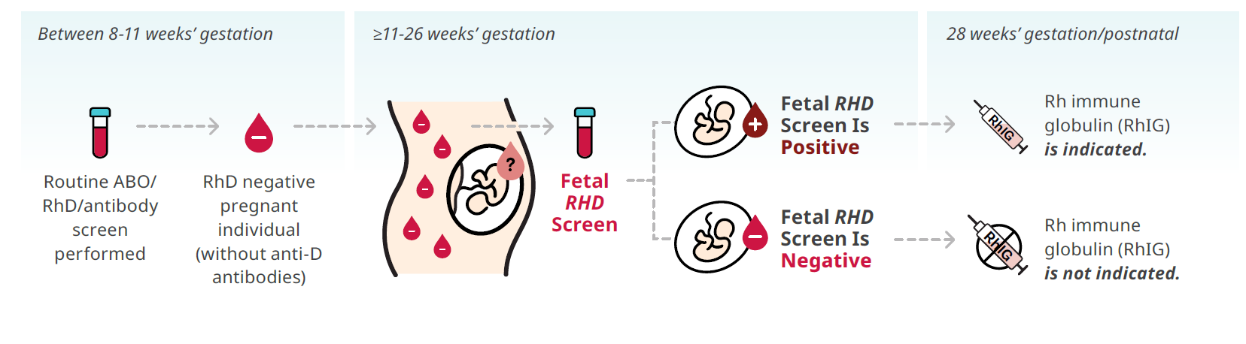
Integrating Fetal RHD Screening into Clinical Practice
*The information presented on this slide is based on current planning and is subject to change. Some details may be updated once agreements are fully executed with testing laboratories. Changes are expected to be minimal and will not significantly alter the overall goals of this new testing.
Notes:
Integrating Fetal RHD Screening into Clinical Practice:
At 8–11 weeks: Blood test for ABO/RhD type and antibody screen as per current practice
If RhD-negative and no anti-D antibodies, provider would order Fetal RHD Screen (available from 11 to 26 weeks gestation)
Results Interpretation:
Positive result: RhIG is indicated at 28 weeks, postnatally, and after sensitizing events
Negative result: RhIG is not indicated; continue with routine pregnancy care
Note: If the fetal RHD screen was positive, postnatal RhIG can be administered without waiting for cord blood results. Cord blood testing will serve as test validation. Any discrepancies should be reported to the testing lab.

Slide 4
Key Information About Fetal RHD Screening
Pregnant individuals with other clinically significant antibodies (e.g., C, c, E, K) remain eligible for fetal RHD screening, provided anti-D is negative.
Publicly funded in Ontario for all RhD negative pregnant individuals who:
Have not developed antibodies towards the RhD antigen (anti-D)
Have a singleton pregnancy
Do not have a known weak D phenotype or RHD variant
Can be performed after 11 weeks’ gestation and blood samples can be drawn at community-based labs
Requisitions can be found at www.prenatalscreeningontario.ca once tests are available
Testing performed at a designated laboratory in Ontario (TBD)
Results report will include RhIG recommendations
Notes:
Test eligibility
Publicly-funded for Ontario residents who are:
RhD negative pregnant individuals
Have not developed antibodies towards the RhD antigen (anti-D)
Have a singleton pregnancy
Do not have a known weak D phenotype or RHD variant
Timing:
Can be performed after 11 weeks’ gestation
Blood Sample:
Can be drawn at community-based labs
Requisitions:
Will be available at www.prenatalscreeningontario.ca once tests are launched
Testing:
Testing performed at a designated laboratory in Ontario (TBD)
Report:
Results report will include RhIG recommendations

Slide 5
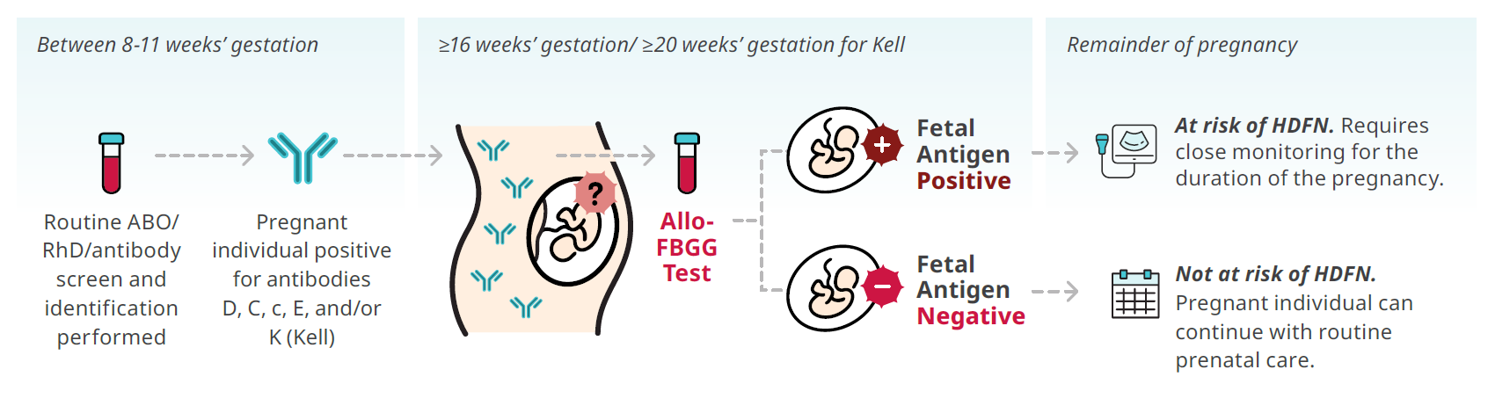

Integrating Alloimmunized Fetal Blood Group Genotyping (Allo-FBGG) into Clinical Practice
Regardless of titre,
can be ordered by primary care or MFM, accessible to all
*The information presented on this slide is based on current planning and is subject to change.
Some details may be updated once agreements are fully executed with testing laboratories.
Changes are expected to be minimal and will not significantly alter the overall goals of this new testing.
Notes:
Integrating Alloimmunized Fetal Blood Group Genotyping (Allo-FBGG) into Clinical Practice
Initial steps remain the same: ABO, RhD, and antibody screening
If the pregnant individual tests positive for anti-D, C, c, E, or K (Kell) antibodies, the alloimmunized FBGG test can be ordered.
Earliest testing:
16 weeks for RhD/C/c/E antigens
20 weeks for K (Kell) antigen
Who can order: Prenatal care providers such as family MD, NP, midwives, OB and MFM, etc.
No minimum antibody titre required
Interpreting results:
Positive result: Fetal antigen is present → pregnancy is at risk for HDFN → close monitoring is required as per current practice
Negative result: Fetal antigen is absent → pregnancy is not at risk → routine prenatal care can resume
During beginning of implementation stage, certain sites will be asked to repeat an antibody titre or Doppler U/S at 28 weeks’ gestation as an extra test validation. This recommendation will be added to the test report for the sites participating in this phase.
Important: Antibody titres and monitoring must continue until FBGG results are available. Do not delay ordering or monitoring while waiting for results.
Cord blood testing for related antigen phenotype will serve as test validation. Any discrepancies should be reported to the testing lab.

Slide 6
Key Information About Allo-FBGG
Publicly funded in Ontario for all pregnant individuals who are alloimmunized towards one or more of the following antigens: RhD, C, c, E, and/or K (Kell)
Can be performed ≥ 16 weeks’ gestation for RhD, C, c, E and ≥ 20 weeks’ gestation for K (Kell)
Blood samples can be drawn at hospital or community-based labs
Testing performed at a designated laboratory in Ontario (TBD)
Requisitions can be found at www.prenatalscreeningontario.ca once tests are available
Results report will include clinical recommendations to guide next steps in pregnancy care
Notes:
Test eligibility
Publicly-funded for Ontario residents who are:
Alloimmunized towards one or more of the following antigens: RhD, C, c, E, and/or K (Kell)
Multiple pregnancies can be tested
For RhD antigens, known weak D phenotype or RHD variant cannot be tested
Timing:
Can be performed ≥ 16 weeks’ gestation for RhD, C, c, E and ≥ 20 weeks’ gestation for K (Kell)
Blood Sample:
Can be drawn at community-based labs
Requisitions:
Will be available at www.prenatalscreeningontario.ca once tests are launched
Testing:
Testing performed at a designated laboratory in Ontario (TBD)
Report:
Results report will include clinical recommendations to guide next steps in pregnancy care

Slide 7
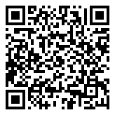
More Information
Contact Us
Subscribe to PSO to get notified when testing becomes available
PSO@BORNontario.ca
613-737-2281 / Toll free: 1-933-351-6490
For Up-To-Date Information
Visit www.PrenatalScreeningOntario.ca
Notes:
For more information:
Subscribe to PSO using the QR code to receive updates as soon as the tests become available.
Contact Prenatal Screening Ontario via:
Email
Phone line
It’s an exciting time with these new tools becoming available. Our goal is to ensure providers are not only aware of these tests but also comfortable ordering them for their patients.

