Slide 1
Reconstitution of Fibrinogen Concentrate (FC) and Prothrombin Complex Concentrate (PCC) Outside of the Transfusion Medicine Laboratory (TML) version 1.1.0
Donna Berta RN, BScN
Clinical Project Coordinator – Nursing
Ontario Regional Blood Coordinating Network (ORBCoN)
December 1, 2025.

Slide 2

Objectives
After completing this learning, participants will be able to:
Define the steps to safely reconstitute FC and PCC (the brands utilized at your hospital).
Identify the documentation requirements for reconstituting FC and PCC.
Describe general considerations when reconstituting FC and PCC outside TML.
Consult your hospital’s policies and procedures for additional details specific to your facility.

Slide 3
Outline (1)
Topic | Slide Number
Rationale for this Learning | 5
Product Learning Modules | 7
Module 1: FC - Fibryga® | 7
Octajet® device | 7
Nextaro® device | 24
Module 2: FC - RiaSTAP® | 41
Module 3: PCC - Beriplex® | 57
Module 4: PCC - Octaplex® | 73
Mix2Vial™ set/device | 73
Nextaro® device | 89
Supplementary Information – Indications | 106

Slide 4
Outline (2)
Topic | Slide Number
Documentation Learning Modules | 109
Module 5: Product Label | 110
Module 6: Transfusion Record | 116
Reconstitution Summary | 120
Resources | 123
Glossary & Abbreviations | 124
References | 126
Acknowledgements | 128
Disclaimer | 129
Questions | 130

Slide 5
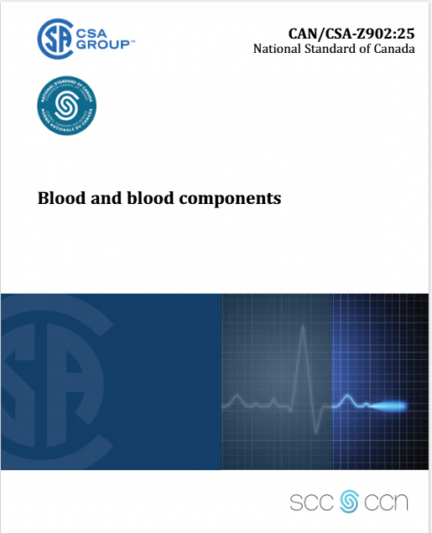
Rationale for this learning: Canadian Transfusion Medicine Standards
Canadian Standards Association Blood and blood components CAN/CSA Z902:25
This Standard has been prepared to maintain and enhance the safety, efficacy, and quality of blood collection, storage, processing, and transfusion. The requirements set out in this Standard are the minimum criteria for acceptable performance and may be exceeded in practice. This Standard must be read in conjunction with Health Canada’s Blood Regulations. In developing this Standard, the Technical Committee extensively consulted equivalent standards in Canada and other jurisdictions, including the Canadian Society for Transfusion Medicine’s Standards for Hospital Transfusion Services and the Association for the Advancement of Blood and Biotherapies’ Standards for Blood Banks and Transfusion Services.
Canadian Standards Association
14.4.1 “Blood products shall be prepared in accordance with the manufacturer’s instructions.”
14.4.2 “All service personnel within and outside the transfusion service who prepare blood products for administration shall be trained and qualified for the functions they perform. Competency shall be assessed following training and at regular intervals thereafter, as determined by the facility.”
14.4.3 “The preparation record shall include the name of the person who prepared the product for administration and the date and time of preparation.”

Slide 6

Rationale for this learning: Canadian Transfusion Medicine Standards
Canadian Society for Transfusion Medicine
2.14 “The transfusion service shall ensure there is a competency program for all medical, clinical and support staff involved in any transfusion related activity, including the preparation of blood components and blood products for administration. The evaluation shall be done following training and at a frequency defined by the facility. The program shall include: a) evaluation of theoretical and practical knowledge b) additional training when indicated.”
5.6.9.1 “Reconstitution of blood products shall follow manufacturer’s recommendations.”
5.6.9.2 “A label shall be applied to reconstituted blood products prior to issue as indicated in 5.6.2 Labelling.”
Canadian Society for Transfusion Medicine Standards for Hospital Transfusion Services Version 5
These standards are to be used by hospitals as a tool for the development of policies, processes and procedures. Transfusion Services must also meet all national, provincial or territorial standards and/or regulations.

Slide 7
Fibryga® Reconstitution Octajet® transfer device
7

Slide 8
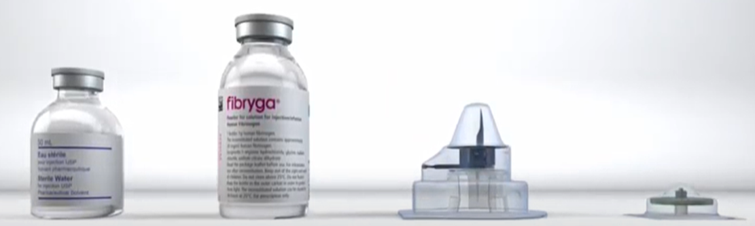
Product Learning Module 1: FC - Fibryga® Octajet® transfer device
REMINDER: Only reconstitute when ready to administer.
Fibryga® is available as 1 g/bottle (vial), reconstituted with 50 mL of solvent (water for injection).
Use appropriate aseptic technique.
Single use only.
TML will provide product label(s) and kit(s) containing: solvent bottle, Fibryga® powder bottle, Octajet® transfer device, filter.
Also required: alcohol swabs, 50 mL syringes, transfer needles, sterile administration bag.

Slide 9
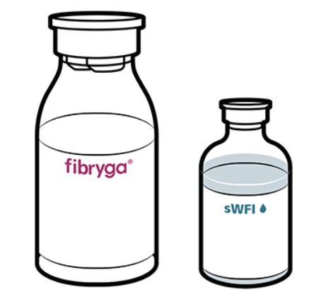
Product Learning Module 1: FC - Fibryga® Octajet® transfer device
Step 1 Check Expiry Date & Temperature
Verify product expiry date (on the kit packaging and the bottles) is acceptable.
Ensure the bottles of both the powder (Fibryga®) and the solvent (sterile water for injection, sWFI) are at room temperature.
During reconstitution, room temperature should be maintained.
Room temperature augments the product powder dissolving.

Slide 10

Product Learning Module 1: FC - Fibryga® Octajet® transfer device
Step 2 Remove Caps, Clean Rubber Stopper of Powder & Solvent Bottles
Remove the cap from both the Fibryga® powder and the solvent (sWFI) bottles.
Using a circular motion, clean the exposed central part of the rubber stopper of both bottles with an alcohol swab.
Allow the stoppers of the bottles to dry.

Slide 11
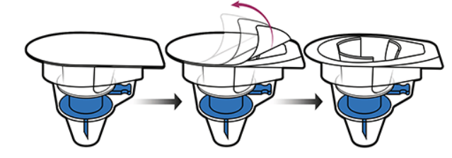
Product Learning Module 1: FC - Fibryga® Octajet® transfer device
Step 3 Open Octajet® Transfer Device
Peel off the paper lid of the Octajet® transfer device.
Leave the Octajet® device in the clear outer packaging to maintain sterility.

Slide 12
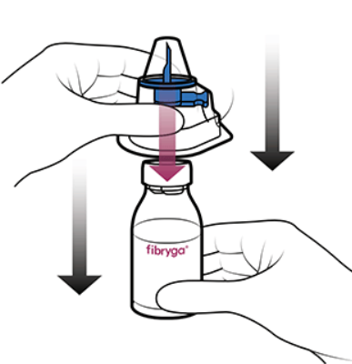
Product Learning Module 1: FC - Fibryga® Octajet® transfer device
Step 4 Attach Octajet® Transfer Device to Powder Bottle
Hold the Fibryga® powder bottle on a firm flat surface.
With the Octajet® device in its outer package, centre and invert the clear spike over the Fibryga® powder bottle; spike it firmly through the centre indented area of the rubber stopper.
Ensure the clear plastic clips of the Octajet® device are securely locked to the neck of the Fibryga® powder bottle.
HINT: Fibryga® reconstitution is unique in that the transfer device is first spiked into the powder bottle, and secondly is the solvent bottle spiking procedure.

Slide 13
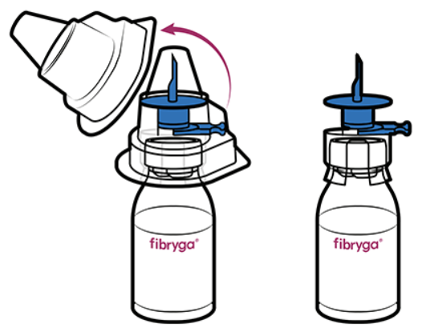
Product Learning Module 1: FC - Fibryga® Octajet® transfer device
Step 5 Expose Blue Spike of Octajet® Transfer Device
Hold onto the Fibryga® powder bottle and carefully remove the clear outer packaging of the Octajet® device to expose the blue solvent spike.
The Octajet® device must remain firmly attached to the Fibryga® powder bottle.
Do not touch the blue solvent spike.

Slide 14
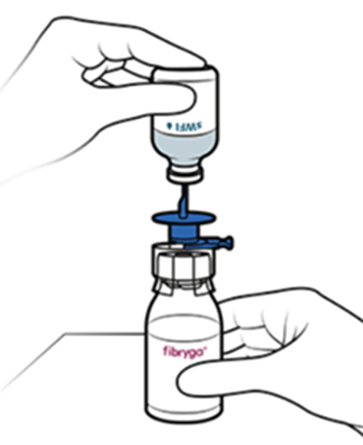
Product Learning Module 1: FC - Fibryga® Octajet® transfer device
Step 6 Connect Solvent Bottle to Octajet® Transfer Device
With one hand, hold the Fibryga® powder bottle on a flat surface.
With the other hand, invert the solvent (sWFI) bottle and place it over the blue solvent spike of the Octajet® device.
In one smooth motion, push downwards so that the blue solvent spike is just through the centre indented area of the rubber stopper of the solvent (sWFI) bottle.
Make sure the solvent (sWFI) bottle fully covers both holes of the blue solvent spike (to prevent loss of vacuum).

Slide 15
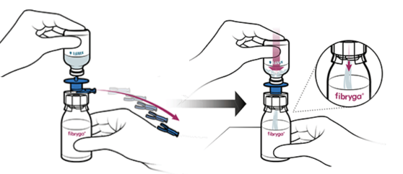
Product Learning Module 1: FC - Fibryga® Octajet® transfer device
Step 7 Remove Blue Spacer Ring to Mix Solvent with Powder
Hold the solvent (sWFI) bottle steady and remove the blue spacer ring by pulling the blue tab (refer to red arrow on diagram).
Press the solvent (sWFI) bottle with downward force (this starts the vacuum).
The solvent (sWFI) will automatically flow into the Fibryga® powder bottle.

Slide 16
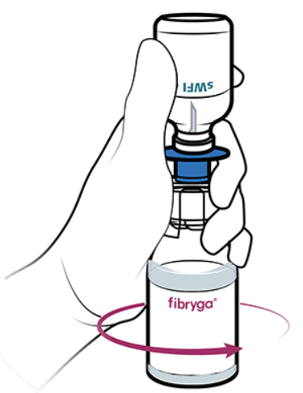
Product Learning Module 1: FC - Fibryga® Octajet® transfer device
Step 8 Swirl Fibryga® to Dissolve
When the solvent (sWFI) has been completely transferred, gently swirl the Fibryga® powder bottle until the powder is completely dissolved.
Do not shake the bottle as this causes foam to form (may lead to denaturation of proteins).
The powder should be fully dissolved within about 5 minutes (should not take longer than 30 minutes).

Slide 17
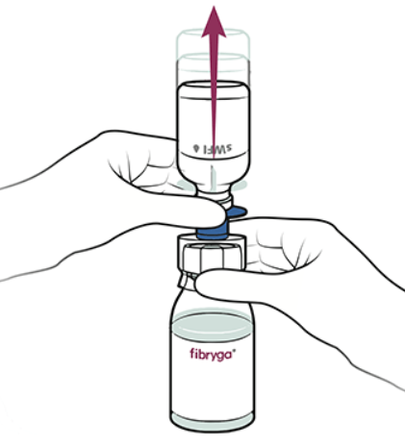
Product Learning Module 1: FC - Fibryga® Octajet® transfer device
Step 9 Unlock Octajet® Transfer Device & Discard Empty Solvent Bottle
Holding the Fibryga® bottle in one hand, secure the clear part of the Octajet® device.
In the other hand, hold the solvent (sWFI) bottle and grasp the blue disc/spike part of the Octajet® device.
Turn this solvent connector about 45 degrees in either direction to unlock it.
In one motion, remove the solvent (sWFI) bottle along with the blue disc/spike.
Both the solvent (sWFI) bottle and the blue disc/spike must be removed to attach the filter (per step 10).

Slide 18
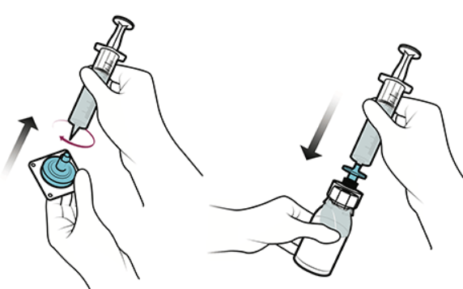
Product Learning Module 1: FC - Fibryga® Octajet® transfer device
Step 10 Draw Air into Syringe & Attach Filter; Connect Syringe/Filter to Octajet® device/Fibryga® bottle; Slowly Inject Air
Draw air into a sterile 50 mL syringe.
Open the paper lid of the filter package.
While holding the filter in its outer packaging, attach the syringe (with the air drawn up) to the filter.
Remove the remaining outer packaging from the filter.
Connect the filter and syringe to the luer lock of the clear Octajet® device that is on the Fibryga® bottle.
With the filter connected to the Octajet® device/Fibryga® bottle, slowly inject air from the syringe into the Fibryga® bottle.

Slide 19
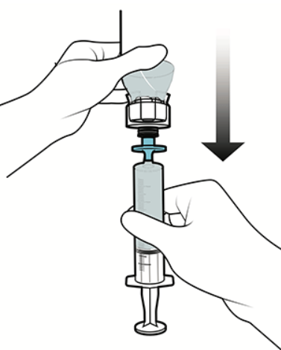
Product Learning Module 1: FC - Fibryga® Octajet® transfer device
Step 11 Withdraw Fibryga® & Prepare for Administration
Invert and withdraw the Fibryga® through the filter into the syringe.
Detach the filled syringe and transfer the Fibryga® to a sterile administration bag.
Visually inspect the product; it should be colourless, not cloudy, and no deposits noted.
Complete product label and apply to the sterile administration bag.
Fibryga® is ready for administration.
Discard bottle, Octajet® device, filter, syringe.

Slide 20
Product Learning Module 1: FC - Fibryga® Octajet® transfer device Reconstitution Summary Steps 1 to 6
1. Check Expiry Date & Temperature: Verify acceptable expiry date. Both the powder & solvent must be at room temperature. 2. Remove Caps, Clean Rubber Stopper of Powder & Solvent Bottles: Use an alcohol swab, let dry. 3. Open Octajet® Transfer Device: Remove the paper lid from the Octajet® device; keep it in its clear outer packaging for sterility. 4. Attach Octajet® Transfer Device to Powder Bottle: Firmly hold the Fibryga® powder bottle on a flat surface. Invert, center, & press the clear spike of the Octajet® device into the indented area of the powder bottle's stopper to lock it in place. 5. Expose Blue Spike of Octajet® Transfer Device: Maintain sterility & carefully remove the Octajet® outer packaging to uncover the blue spike. 6. Connect Solvent Bottle to Octajet® Transfer Device: Invert the solvent bottle over the blue spike; push downwards so the spike is just through the indented area of the stopper. Ensure the solvent bottle fully covers both holes of the blue spike.

Slide 21
Product Learning Module 1: FC - Fibryga® Octajet® transfer device Reconstitution Summary Steps 7 to 11
7. Remove Blue Spacer Ring to Mix Solvent with Powder: Hold the solvent bottle steady & remove the blue spacer ring from the Octajet® device by pulling the tab. Press down on the solvent bottle, it will automatically flow into the powder bottle. 8. Swirl Fibryga® to Dissolve: Gently swirl the Fibryga® powder bottle until fully dissolved (5-30 minutes). DO NOT SHAKE. 9. Unlock Octajet® Transfer Device & Discard Empty Solvent Bottle: Hold the Fibryga® bottle securing the clear part of the Octajet® device. Turn the blue disc of Octajet® 45 degrees. Remove the empty solvent bottle along with the blue disc/spike. 10. Draw Air into Syringe & Attach Filter; Connect Syringe/Filter to Octajet® device/Fibryga® bottle; Slowly Inject Air: Draw air into a 50 mL syringe. Using sterile technique, open the lid of the filter package & attach the 50 mL syringe. Connect the syringe/filter to the luer lock of the clear Octajet® device on the Fibryga® bottle. Slowly inject air from the syringe into the Fibryga® bottle. 11. Withdraw Fibryga® & Prepare for Administration: Withdraw reconstituted Fibryga® through the filter into the syringe. Transfer to sterile administration bag, visually inspect, & label the product.

Slide 22
Product Learning Module 1: FC - Fibryga®
Administration Notes (1)
Fibryga® is available as 1 g per bottle. Carefully review the prescriber’s order. More than 1 bottle may be required to provide the dose that was ordered. As required, reconstituted Fibryga® from additional bottles may be added to the same sterile administration bag (pooled).
Following reconstitution, Fibryga® should be used immediately. If not, storage times and conditions are the responsibility of the facility (risk of microbial contamination, manufacturer notes stability of the reconstituted solution has been confirmed for up to 24 hours at +25°C).
Reconstituted solution is colourless. Do not administer if cloudy or deposits are observed.
Administer at room temperature.
Do not further dilute in any IV solutions. Do not mix with any other medicinal products.
Fibryga® is compatible with 0.9 % sodium chloride (NaCl).

Slide 23
Product Learning Module 1: FC - Fibryga®
Administration Notes (2)
Administer only intravenously via a separate injection/infusion line. For infusion, use a standard IV infusion set (has been filtered as part of reconstitution procedure).
Flush the IV site with 0.9 % NaCl flush syringe prior to and following administration.
Monitoring the patient’s fibrinogen level before and during treatment is recommended.
Indication / Rate
Congenital Afibrinogenemia and Hypofibrinogenemia Recommended maximum rate 5 mL per minute (300 mL/hour)
Acquired Fibrinogen Deficiency Recommended maximum rate 20 mL per minute (1200 mL/hour)

Slide 24
Fibryga® Reconstitution Nextaro® transfer device

Slide 25
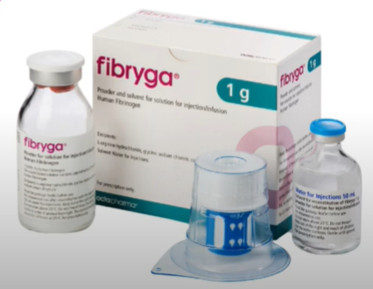
Product Learning Module 1: FC - Fibryga® Nextaro® transfer device
REMINDER: Only reconstitute when ready to administer.
Fibryga® is available as 1 g/bottle (vial), reconstituted with 50 mL of solvent (sterile water for injection).
Use appropriate aseptic technique.
Single use only.
TML will provide product label(s) and kit(s) containing: Fibryga® powder bottle, Nextaro® transfer device, solvent (sterile water for injection) bottle.
Also required: alcohol swabs, 50 mL syringe, transfer needle, sterile administration bag.

Slide 26
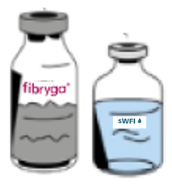
Product Learning Module 1: FC - Fibryga® Nextaro® transfer device
Step 1 Check Expiry Date & Temperature
Verify product expiry date (on the kit packaging and the bottles) is acceptable.
Ensure the bottles of both the powder (Fibryga®) and the solvent (sterile water for injection, sWFI) are at room temperature.
During reconstitution, room temperature should be maintained.
Room temperature augments the product powder dissolving.

Slide 27

Product Learning Module 1: FC - Fibryga® Nextaro® transfer device
Step 2 Remove Caps, Clean Rubber Stopper of Powder & Solvent Bottles
Remove the cap from both the Fibryga® powder and the solvent (sWFI) bottles.
Using a circular motion, clean the exposed central part of the rubber stopper of both bottles with an alcohol swab.
Allow the stoppers of the bottles to dry.

Slide 28
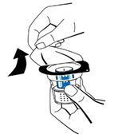
Product Learning Module 1: FC - Fibryga® Nextaro® transfer device
Step 3 Open Nextaro® Transfer Device
Peel off the paper lid of the Nextaro® transfer device.
Leave the Nextaro® device in the clear outer packaging to maintain sterility.
Avoid touching the blue spike to maintain sterility.

Slide 29
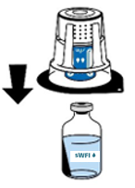
Product Learning Module 1: FC - Fibryga® Nextaro® transfer device
Step 4 Attach Nextaro® Transfer Device to Solvent Bottle
Firmly hold the solvent (sWFI) bottle on a flat surface.
With the Nextaro® device in its outer package, align the blue part on top of the solvent (sWFI) bottle.
Firmly press straight down until it snaps into place on the solvent (sWFI) bottle. While attaching, do not use a twisting motion.
The Nextaro® transfer device must be attached to the solvent (sWFI) bottle first, and then to the Fibryga® powder bottle [to prevent loss of vacuum and failure of the solvent (sWFI) to transfer].

Slide 30
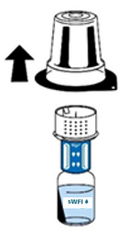
Product Learning Module 1: FC - Fibryga® Nextaro® transfer device
Step 5 Expose White Part of Nextaro® Transfer Device
Firmly hold the solvent (sWFI) bottle. Carefully remove the clear outer packaging of the Nextaro® device by pulling vertically upwards.
Ensure the Nextaro® device remains firmly attached to the solvent (sWFI) bottle.
Do not touch the exposed white part of the Nextaro® device to maintain sterility.

Slide 31

Product Learning Module 1: FC - Fibryga® Nextaro® transfer device
Step 6 Connect Solvent Bottle/Nextaro® Transfer Device to the Powder Bottle
With one hand, hold the Fibryga® powder bottle on a flat surface.
With the other hand, invert the solvent (sWFI) bottle/Nextaro® device, aligning the white part of the Nextaro® device on top of the Fibryga® powder bottle.
Firmly press straight down until the white part of the Nextaro® device snaps into place on the Fibryga® powder bottle. While attaching, do not use a twisting motion.
The solvent (sWFI) will automatically flow into the Fibryga® powder bottle.

Slide 32
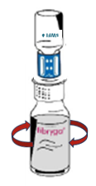
Product Learning Module 1: FC - Fibryga® Nextaro® transfer device
Step 7 Swirl Fibryga® to Dissolve
When the solvent (sWFI) has been completely transferred, gently swirl the Fibryga® powder bottle [with the solvent (sWFI) bottle still attached] until the powder is completely dissolved.
Do not shake the bottle as this causes foam to form (may lead to denaturation of proteins).
The powder should be fully dissolved within about 5 minutes (should not take longer than 30 minutes).
Rarely, a partially dissolved product cake may be observed. To promote dissolution, horizontally agitate. Do not shake the bottle vertically.

Slide 33
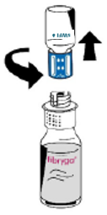
Product Learning Module 1: FC - Fibryga® Nextaro® transfer device
Step 8 Unscrew Nextaro® Transfer Device; Discard Blue Part & Empty Solvent Bottle
Firmly hold the Fibryga® bottle with one hand.
With the other hand, grasp the blue part of the Nextaro® device; turn counterclockwise to unscrew the device into two separate pieces, with the bottles still attached to the respective Nextaro® device parts.
Discard the blue part of the Nextaro® device and the empty solvent (sWFI) bottle.
The white part of the Nextaro® device must remain attached to the Fibryga® bottle because it includes the filter.
Do not touch the luer lock connector on the white part of the Nextaro® device to maintain sterility.

Slide 34
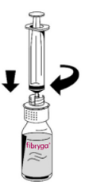
Product Learning Module 1: FC - Fibryga® Nextaro® transfer device
Step 9 Draw Air into Syringe; Connect Syringe to Nextaro® device/Fibryga® bottle; Slowly Inject Air.
Draw air into a sterile 50 mL syringe.
Keeping the Fibryga® bottle upright, carefully connect (by turning clockwise) the syringe to the luer lock connector on the white part of the Nextaro® device that is on the Fibryga® bottle.
Slowly inject air from the syringe into the Fibryga® bottle.

Slide 35

Product Learning Module 1: FC - Fibryga® Nextaro® transfer device
Step 10 Withdraw Fibryga® & Prepare for Administration
Invert the syringe/white part of Nextaro® device/Fibryga® bottle and withdraw the Fibryga® solution through the white part of the Nextaro® device (contains the filter) into the syringe.
Firmly hold the barrel of the filled syringe (keeping the plunger directed downwards) and detach the white part of Nextaro® device/empty Fibryga® bottle from the syringe.
Transfer the Fibryga® from the syringe to a sterile administration bag.
Visually inspect the product; it should be colourless, not cloudy, and no deposits noted.
Complete product label and apply to sterile administration bag.
Fibryga® is ready for administration.
Discard the white part of Nextaro® device/empty Fibryga® bottle, syringe.

Slide 36
Product Learning Module 1: FC - Fibryga® Nextaro® transfer device Reconstitution Summary Steps 1 to 5
1. Check Expiry Date & Temperature: Verify acceptable expiry date. Both the powder & solvent (sWFI) must be at room temperature. 2. Remove Caps, Clean Rubber Stopper of Powder & Solvent Bottles: Use an alcohol swab, let dry. 3. Open Nextaro® Transfer Device: Remove the paper lid from the Nextaro® device. For sterility, keep it in its clear outer packaging & do not touch the blue spike. 4. Attach Nextaro® Transfer Device to Solvent Bottle: Firmly hold the solvent (sWFI) bottle on a flat surface. With the Nextaro® device in its outer package, align the blue part on top of the solvent (sWFI) bottle. Firmly press straight down until it snaps into place on the solvent bottle; do not use a twisting motion. 5. Expose White Part of Nextaro® Transfer Device: Maintain sterility & carefully remove the Nextaro® device outer packaging by pulling vertically upwards. Do not touch the exposed white part of the Nextaro® device.

Slide 37
Product Learning Module 1: FC - Fibryga® Nextaro® transfer device Reconstitution Summary Steps 6 to 8
6. Connect Solvent Bottle/Nextaro® Transfer Device to the Powder Bottle: Invert the solvent (sWFI) bottle/Nextaro® device, aligning the white part of the Nextaro® device on top of the Fibryga® powder bottle. Firmly press straight down until the white part of the Nextaro® device snaps into place; do not use a twisting motion. Solvent (sWFI) will automatically flow into the Fibryga® powder bottle. 7. Swirl Fibryga® to Dissolve: Gently swirl the Fibryga® powder bottle [with the solvent (sWFI) bottle still attached] until the powder is completely dissolved (5-30 minutes). Do not shake. 8. Unscrew Nextaro® Transfer Device; Discard Blue Part & Empty Solvent Bottle: Firmly hold the Fibryga® bottle. Grasp the blue part of the Nextaro® device; turn counterclockwise to unscrew the device into two separate pieces with the bottles still attached. Discard the blue part of the Nextaro® device & empty solvent (sWFI) bottle.

Slide 38
Product Learning Module 1: FC - Fibryga® Nextaro® transfer device Reconstitution Summary Steps 9 to 10
9. Draw Air into Syringe; Connect Syringe to Nextaro® device/Fibryga® bottle; Slowly Inject Air: Draw air into a sterile 50 mL syringe. Keeping the Fibryga® bottle upright, connect (turn clockwise) the syringe to the luer lock connector on the white part of the Nextaro® device that is on the Fibryga® bottle. Slowly inject the air.
10. Withdraw Fibryga® & Prepare for Administration: Withdraw reconstituted Fibryga® through the white part of the Nextaro® device (contains the filter) into the syringe. Firmly hold the barrel of the syringe (keeping the plunger directed downwards) & detach the white part of Nextaro® device/empty Fibryga® bottle from the syringe. Transfer to sterile administration bag, visually inspect, & label the product.

Slide 39
Product Learning Module 1: FC - Fibryga®
Administration Notes (1)
Fibryga® is available as 1 g per bottle. Carefully review the prescriber’s order. More than 1 bottle may be required to provide the dose that was ordered. As required, reconstituted Fibryga® from additional bottles may be added to the same sterile administration bag (pooled).
Following reconstitution, Fibryga® should be used immediately. If not, storage times and conditions are the responsibility of the facility (risk of microbial contamination, manufacturer notes stability of the reconstituted solution has been confirmed for up to 24 hours at +25°C).
Reconstituted solution is colourless. Do not administer if cloudy or deposits are observed.
Administer at room temperature.
Do not further dilute in any IV solutions. Do not mix with any other medicinal products.
Fibryga® is compatible with 0.9 % sodium chloride (NaCl).

Slide 40
Product Learning Module 1: FC - Fibryga®
Administration Notes (2)
Administer only intravenously via a separate injection/infusion line. For infusion, use a standard IV infusion set (has been filtered as part of reconstitution procedure).
Flush the IV site with 0.9 % NaCl flush syringe prior to and following administration.
Monitoring the patient’s fibrinogen level before and during treatment is recommended.
Indication / Rate
Congenital Afibrinogenemia and Hypofibrinogenemia Recommended maximum rate 5 mL per minute (300 mL/hour)
Acquired Fibrinogen Deficiency Recommended maximum rate 20 mL per minute (1200 mL/hour)

Slide 41
RiaSTAP® Reconstitution

Slide 42
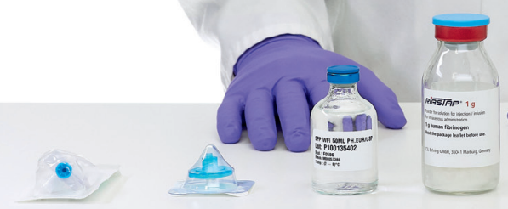
Product Learning Module 2: FC - RiaSTAP®
REMINDER: Only reconstitute when ready to administer.
RiaSTAP® is available as 1 g/bottle (vial), reconstituted with 50 mL of solvent (water for injection).
Use appropriate aseptic technique.
Single use only.
TML will provide product label(s) and kit(s) containing: Mini-Spike® dispensing pin, Pall® syringe filter, solvent bottle, RiaSTAP® powder bottle.
Also required: alcohol swabs, 50 mL syringes, transfer needles, sterile administration bag.

Slide 43
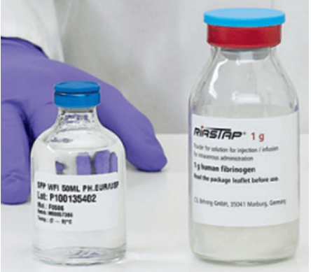
Product Learning Module 2: FC - RiaSTAP®
Step 1 Check Expiry Date & Temperature
Verify product expiry date (on the kit packaging and the bottles) is acceptable.
Ensure the bottles of both the solvent and the powder are at room temperature.
RiaSTAP® is stored refrigerated between +2°C and +8°C.
To bring the RiaSTAP® powder bottle to room temperature, gently roll the bottle in your hand (avoid shaking the bottle).
During reconstitution, room temperature should be maintained.
Room temperature augments the product powder dissolving.

Slide 44
Product Learning Module 2: FC - RiaSTAP®
Step 2 Remove Caps, Clean Rubber Stopper of Powder & Solvent Bottles
Remove the cap from both the solvent and the powder bottles.
Using a circular motion, clean the exposed central part of the rubber stopper of both bottles with an alcohol swab.
Allow the stoppers of the bottles to dry.

Slide 45
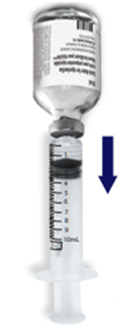
Product Learning Module 2: FC - RiaSTAP®
Step 3 Draw up 50 mL of Solvent
Using a 50 mL syringe and a transfer needle, remove the 50 mL of water for injection from the solvent bottle (the diagram depicts a 10 mL syringe; in actual practice a 50 mL syringe is used).

Slide 46
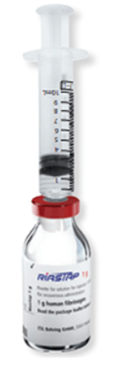
Product Learning Module 2: FC - RiaSTAP®
Step 4 Add Solvent to RiaSTAP® Powder Bottle
With the RiaSTAP® powder bottle on a firm flat surface, transfer the 50 mL of water for injection from the syringe into the bottle (the diagram depicts a 10 mL syringe; in actual practice a 50 mL syringe is used).
Aim the stream of the water for injection down the side of the powder bottle (verses directly onto the powder) to minimize clumping.

Slide 47
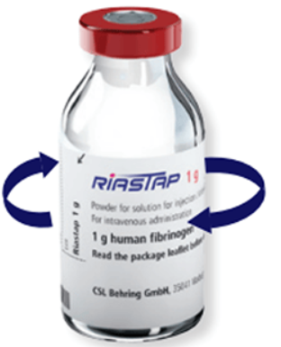
Product Learning Module 2: FC - RiaSTAP®
Step 5 Swirl RiaSTAP® to Dissolve
Gently swirl the RiaSTAP® powder bottle until the powder is completely dissolved.
The powder should be fully dissolved within about 5 to 10 minutes.
Do not shake the bottle as this causes the product to foam (may lead to denaturation of proteins).

Slide 48
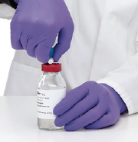
Product Learning Module 2: FC - RiaSTAP®
Step 6 Insert Mini-Spike® Dispensing Pin into RiaSTAP® bottle
Open the plastic blister package containing the Mini-Spike® dispensing pin and insert it into the stopper of the reconstituted RiaSTAP® bottle.

Slide 49
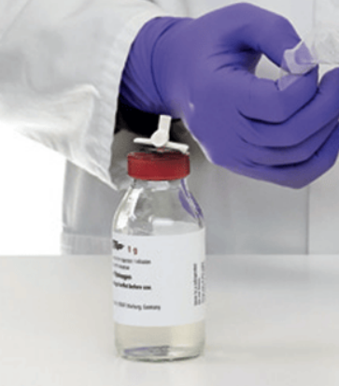
Product Learning Module 2: FC - RiaSTAP®
Step 7 Remove Blue Cap from Mini-Spike® Dispensing Pin
Carefully remove the blue cap of the Mini-Spike® dispensing pin.
Do not touch the white exposed dispensing pin surface.

Slide 50
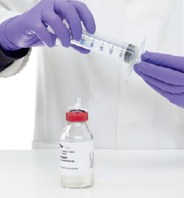
Product Learning Module 2: FC - RiaSTAP®
Step 8 Prepare Pall® Syringe Filter
Open the plastic blister package of the Pall® syringe filter.
Screw a new 50 mL syringe onto the syringe filter.

Slide 51
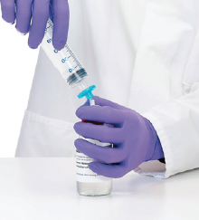
Product Learning Module 2: FC - RiaSTAP®
Step 9 Connect the Pall® Syringe Filter & the Mini-Spike® Dispensing Pin (on the RiaSTAP® bottle)
Screw the Pall® syringe filter with the 50 mL syringe attached onto the Mini-Spike® dispensing pin that was inserted into the reconstituted RiaSTAP® bottle.

Slide 52
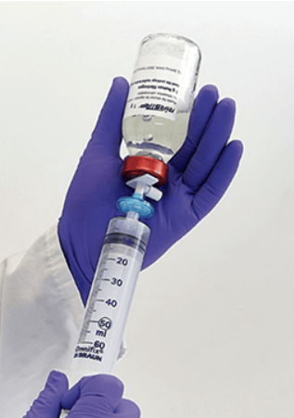
Product Learning Module 2: FC - RiaSTAP®
Step 10 Withdraw RiaSTAP® & Prepare for Administration
Invert the bottle and withdraw the RiaSTAP® through the Pall® syringe filter into the 50 mL syringe.
Detach the filled syringe and transfer the RiaSTAP® to a sterile administration bag.
Visually inspect the product; it should be colourless and clear to slightly opalescent, not cloudy and no deposits noted.
Complete product label and apply to the sterile administration bag.
RiaSTAP® is ready for administration.
Discard bottles, dispensing pin device, filter, syringes.

Slide 53
Product Learning Module 2: FC - RiaSTAP® Reconstitution Summary Steps 1 to 6
Check Expiry Date & Temperature: Verify acceptable expiry date. Both the powder & solvent must be at room temperature. As needed, for the RiaSTAP® powder, gently roll the bottle in your hand.
Remove Caps, Clean Rubber Stopper of Powder & Solvent Bottles: Use an alcohol swab, let dry.
Draw up 50 mL of Solvent: Using a needle & 50 mL syringe, draw 50 mL of water for injection from the solvent bottle.
Add Solvent to RiaSTAP® Powder Bottle: With the RiaSTAP® powder bottle on a firm flat surface, transfer the 50 mL of water for injection into the powder bottle.
Swirl RiaSTAP® to Dissolve: Gently swirl the RiaSTAP® powder bottle until fully dissolved (5-10 minutes). DO NOT SHAKE.
Insert Mini-Spike® Dispensing Pin into RiaSTAP® bottle: Insert the Mini-Spike® dispensing pin into the stopper of the RiaSTAP® bottle.

Slide 54
Product Learning Module 2: FC - RiaSTAP® Reconstitution Summary Steps 7 to 10
7. Remove Blue Cap from Mini-Spike® Dispensing Pin: Remove the dispensing pin’s blue cap. Maintain sterility of the white dispensing pin.
8. Attach 50 mL Syringe to Pall® Syringe Filter: Open the blister package of the Pall® syringe filter & screw a new 50 mL syringe onto it.
9. Connect the Pall® Syringe Filter & the Mini-Spike® Dispensing Pin (on the RiaSTAP® bottle): Screw the Pall® syringe filter, with the syringe attached, onto the Mini-Spike® dispensing pin that was inserted into the RiaSTAP® bottle.
10. Withdraw RiaSTAP® & Prepare for Administration: Invert & withdraw the reconstituted RiaSTAP® through the filter into the syringe. Transfer to sterile administration bag, visually inspect, & label the product.

Slide 55
Product Learning Module 2: FC - RiaSTAP®
Administration Notes (1)
RiaSTAP® is available as 1 g per bottle. Carefully review the prescriber’s order. More than 1 bottle may be required to provide the dose that was ordered. As required, reconstituted RiaSTAP® from additional bottles may be added to the same sterile administration bag (pooled).
Following reconstitution, RiaSTAP® should be used immediately. RiaSTAP® is stable for 8 hours after reconstitution when stored at room temperature (+20°C to 25°C) and should be administered within this time period.
Reconstituted solution is colourless and clear to slightly opalescent. Do not administer if cloudy or particles are observed.
Administer at room temperature.
Do not further dilute in any IV solutions. Do not mix with any other medicinal products.
RiaSTAP® is compatible with 0.9 % sodium chloride (NaCl).

Slide 56
Product Learning Module 2: FC - RiaSTAP®
Administration Notes (2)
Administer only intravenously via a separate injection/infusion line. For infusion, use a standard IV infusion set (has been filtered as part of reconstitution procedure).
Flush the IV site with 0.9 % NaCl flush syringe prior to and following administration.
Monitoring the patient’s fibrinogen level before and during treatment is recommended.
Indication / Rate
Congenital Afibrinogenemia and Hypofibrinogenemia
Recommended maximum rate 5 mL per minute (300 mL/hour)

Slide 57
Beriplex® Reconstitution

Slide 58
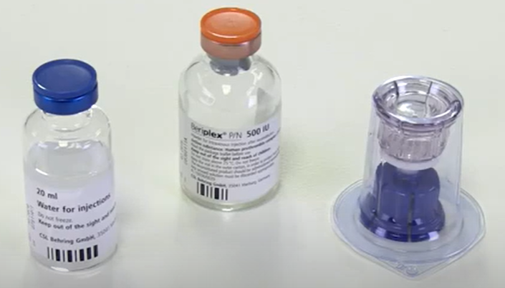
Product Learning Module 3: PCC - Beriplex®
REMINDER: Only reconstitute when ready to administer.
Beriplex® is available as 500 IU in 20 mL bottle/vial and 1000 IU in 40 mL bottle/vial; reconstituted with 20 mL and 40 mL, respectively, of solvent (water for injection, WFI).
Use appropriate aseptic technique.
Single use only.
TML will provide product label(s) and kit(s) containing: solvent bottle (WFI), Beriplex® powder bottle, Mix2Vial™ transfer set.
Also required: alcohol swabs, syringes (appropriate size, depending on dose), transfer needles, sterile administration bag.

Slide 59
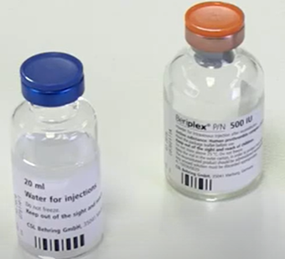
Product Learning Module 3: PCC - Beriplex®
Step 1 Check Date Expiry & Temperature
Verify product expiry date (on the kit packaging and the bottles) is acceptable.
Ensure the bottles of both the solvent (water for injection, WFI) and the powder are at room temperature.
During reconstitution, room temperature should be maintained.
Room temperature augments the product powder dissolving.

Slide 60
Product Learning Module 3: PCC - Beriplex®
Step 2 Remove Caps, Clean Rubber Stopper of Powder & Solvent Bottles
Remove the cap from both the solvent (WFI) and the powder bottles.
Using a circular motion, clean the exposed central part of the rubber stopper of both bottles with an alcohol swab.
Allow the stoppers of the bottles to dry.

Slide 61
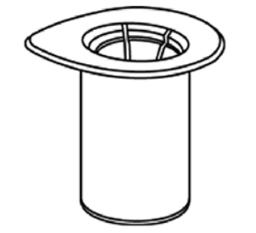
Product Learning Module 3: PCC - Beriplex®
Step 3 Peel Paper Lid off the Mix2Vial™ Transfer Set
Peel the paper lid off the Mix2Vial™ transfer set.
Leave the Mix2Vial™ transfer set in the clear blister package to maintain sterility.

Slide 62
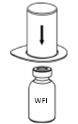
Product Learning Module 3: PCC - Beriplex®
Step 4 Connect Mix2Vial™ Transfer Set to Solvent Bottle
Place the solvent (WFI) bottle on a flat surface and hold the bottle steady.
Invert and centre the Mix2Vial™ transfer set in its clear blister package over the solvent (WFI) bottle.
In one smooth motion, push the blue spike part of the Mix2Vial™ transfer set straight down through the stopper of the solvent (WFI) bottle.
HINT: blue to blue (the Mix2Vial™ transfer set blue spike part goes onto the solvent (WFI) bottle which has a blue metal rim).

Slide 63

Product Learning Module 3: PCC - Beriplex®
Step 5 Remove Mix2Vial™ Transfer Set Clear Blister Packaging
Securely hold the solvent (WFI) bottle and cautiously pull the clear blister package upwards to remove it from Mix2Vial™ transfer set.
Ensure the Mix2Vial™ transfer set remains firmly attached to the solvent (WFI) bottle.

Slide 64
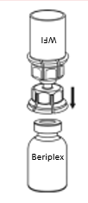
Product Learning Module 3: PCC - Beriplex®
Step 6 Add Solvent to Beriplex® Powder Bottle
Hold the Beriplex® powder bottle steady on a firm flat surface, and invert the solvent (WFI) bottle (with the Mix2Vial™ transfer set attached).
Firmly push the transparent spike part of the Mix2Vial™ transfer set straight down through the stopper of the Beriplex® powder bottle.
The solvent (WFI) will automatically flow into the Beriplex® powder bottle.

Slide 65
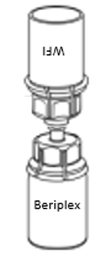
Product Learning Module 3: PCC - Beriplex®
Step 7 Slowly Swirl to Dissolve
With solvent (WFI) and Beriplex® bottles still attached, gently and slowly swirl/rotate the Beriplex® bottle until the product is fully dissolved.
Do not shake.

Slide 66
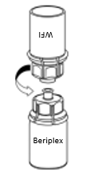
Product Learning Module 3: PCC - Beriplex®
Step 8 Separate Mix2Vial™ Transfer Set; Discard the Blue part with the Empty Solvent Bottle
With one hand, firmly hold the transparent (product side) part and with the other hand, firmly hold the blue (WFI side) part of the Mix2Vial™ transfer set.
Unscrew (turn counterclockwise) the Mix2Vial™ transfer set into two separate pieces with the bottles still attached.
Discard the blue part of the Mix2Vial™ transfer set and the empty solvent (WFI) bottle.
The transparent part of the Mix2Vial™ transfer set must remain attached to the Beriplex® bottle because it includes the filter.

Slide 67

Product Learning Module 3: PCC - Beriplex®
Step 9 Draw Air into syringe. Connect syringe to transparent part of Mix2Vial™ set/Beriplex® bottle. Slowly Inject Air.
Draw air into a sterile syringe (appropriate size, depending on the dose of Beriplex® that is being reconstituted).
Keeping the Beriplex® bottle upright, connect (by turning clockwise) the syringe to the transparent part of the Mix2Vial™ transfer set (which is attached to the reconstituted Beriplex® bottle).
Slowly inject air into the Beriplex® bottle.

Slide 68


Product Learning Module 3: PCC - Beriplex®
Step 10 Withdraw Beriplex® & Prepare for Administration
Keep the plunger of the syringe pressed in and invert the syringe-Beriplex® bottle.
Withdraw the Beriplex® through the filter of the transparent part of Mix2Vial™ transfer set into the syringe.
After the Beriplex® has been transferred into the syringe, firmly hold the barrel of the syringe (keeping the plunger directed downwards) and detach (turn counterclockwise) the Mix2Vial™ transfer set and empty bottle from the syringe.
Transfer the Beriplex® from the syringe to a sterile administration bag.
Visually inspect the product; it should be clear to slightly opalescent, not cloudy and no deposits noted.
Complete product label and apply to the sterile administration bag.
Beriplex® is ready for administration.
Discard bottle, transparent part of Mix2Vial™ transfer set, syringe.

Slide 69
Product Learning Module 3: PCC - Beriplex® Reconstitution Summary Steps 1 to 6
Check Expiry Date & Temperature: Verify acceptable expiry date. Both the powder & solvent must be at room temperature.
Remove Caps, Clean Rubber Stopper of Powder & Solvent Bottles: Use an alcohol swab, let dry.
Peel Paper Lid off the Mix2Vial™ Transfer Set: Peel off the paper lid from the Mix2Vial™ transfer set; keep it in the clear blister package.
Connect Mix2Vial™ Transfer Set to Solvent Bottle: Place the solvent bottle on a flat surface, hold it steady. Invert & center the Mix2Vial™ set (blue end) over the solvent (WFI) bottle, then push the blue spike down through the stopper of the bottle.
Remove Mix2Vial™ Transfer Set Clear Blister Packaging: Securely hold the solvent (WFI) bottle & pull upwards to remove the clear blister package from the Mix2Vial™ set.
Add Solvent to Beriplex® Powder Bottle: Hold the Beriplex® powder bottle on a flat surface. Invert the solvent (WFI) bottle & push the transparent spike of the Mix2Vial™ set straight down through the stopper of the powder bottle. The solvent (WFI) will automatically flow into the Beriplex® powder bottle.

Slide 70
Product Learning Module 3: PCC - Beriplex® Reconstitution Summary Steps 7 to 10
7. Slowly Swirl to Dissolve: With the bottles connected via the Mix2Vial™ transfer set, slowly swirl/rotate the Beriplex® powder bottle until fully dissolved.
8. Separate Mix2Vial™ Transfer Set; Discard the Blue part with the Empty Solvent Bottle: Unscrew (turn counterclockwise) the Mix2Vial™ transfer set into two separate parts (blue & transparent), carefully keeping the solvent (WFI) & powder bottles attached. Discard the Mix2Vial™ set blue part & empty solvent (WFI) bottle.
9. Draw Air into syringe. Connect syringe to transparent part of Mix2Vial™ set/Beriplex® bottle. Slowly Inject Air: Draw air into a sterile syringe (appropriate size, depending on the Beriplex® dose). Connect the syringe to the transparent part of the Mix2Vial™ set that is attached to the upright Beriplex® bottle & slowly inject the air.
10. Withdraw Beriplex® & Prepare for Administration: Keep the plunger of the syringe pressed in & invert the syringe-Beriplex® bottle. Withdraw reconstituted Beriplex® through the transparent part of the Mix2Vial™ set (contains the filter) into the syringe by slowly pulling the plunger back. Firmly hold the barrel of the syringe (keeping the plunger directed downwards) and detach (turn counterclockwise) the Mix2Vial™ transfer set and empty bottle from the syringe. Transfer to sterile administration bag, visually inspect, & label the product.

Slide 71
Product Learning Module 3: PCC - Beriplex®
Administration Notes (1)
Beriplex® is available as 500 IU in 20 mL bottle and 1000 IU in 40 mL bottle. Carefully review the product provided from TML and the prescriber’s order. More than 1 bottle may be required to provide the dose that was ordered. As required, reconstituted Beriplex® from additional bottles may be added to the same sterile administration bag (pooled).
To ensure sterility, following reconstitution, Beriplex® should be used immediately. (contains no preservatives). Storage must not exceed 3 hours at room temperature.
Reconstituted solution is clear or slightly opalescent. Do not administer if cloudy or deposits are observed.
Administer at room temperature.
Do not further dilute in any IV solutions. Do not mix with any other medicinal products.
Beriplex® is compatible with 0.9 % sodium chloride (NaCl).
Administer only intravenously via a separate injection/infusion line. For infusion, use a standard IV infusion set (has been filtered as part of reconstitution procedure).

Slide 72
Product Learning Module 3: PCC - Beriplex®
Administration Notes (2)
Flush the IV site with 0.9 % NaCl flush syringe prior to and following administration.
NOTE: PCC is CONTRAINDICATED in patients with heparin-induced thrombocytopenia (HIT) or with known allergies to heparin (Beriplex® contains heparin).
Monitoring blood coagulation with appropriate coagulation assays (plasma levels of individual coagulation factors, or global tests of prothrombin complex levels [prothrombin time, INR]) before and during treatment is recommended.
Indication / Rate
Treatment of bleeding and perioperative prophylaxis of bleeding in acquired deficiency of the prothrombin complex coagulation factors (factors II, VII, IX and X). For example, deficiency caused by treatment with vitamin K antagonists, or in case of overdose of vitamin K antagonists, when rapid correction of the deficiency is required (life threatening bleeding or emergency surgical interventions).
Recommended maximum infusion rate: 8 mL per minute (480 mL/hour).

Slide 73
Octaplex® Reconstitution Mix2Vial™ transfer set/device

Slide 74
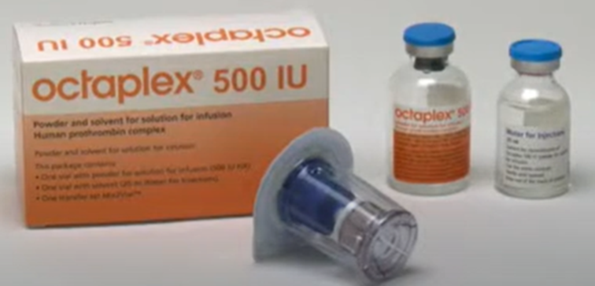
Product Learning Module 4: PCC - Octaplex® Mix2Vial™ transfer set/device
REMINDER: Only reconstitute when ready to administer.
Octaplex® is available as 500 IU in 20 mL bottle/vial and 1000 IU in 40 mL bottle/vial; reconstituted with 20 mL and 40 mL, respectively, of solvent (water for injection, WFI).
Use appropriate aseptic technique.
Single use only.
TML will provide product label(s) and kit(s) containing: Mix2Vial™ transfer set, Octaplex® powder bottle, solvent (WFI) bottle.
Also required: alcohol swabs, syringes (appropriate size, depending on dose), transfer needles, sterile administration bag.

Slide 75
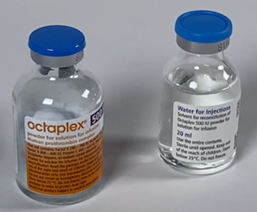
Product Learning Module 4: PCC - Octaplex® Mix2Vial™ transfer set/device
Step 1 Check Date Expiry & Temperature
Verify product expiry date (on the kit packaging and the bottles) is acceptable.
Ensure the bottles of both the powder and the solvent (WFI) are at room temperature.
During reconstitution, room temperature should be maintained.
Room temperature augments the product powder dissolving.

Slide 76
Product Learning Module 4: PCC - Octaplex® Mix2Vial™ transfer set/device
Step 2 Remove Caps, Clean Rubber Stopper of Powder & Solvent Bottles
Remove the cap from both the powder and the solvent (WFI) bottles.
Using a circular motion, clean the exposed central part of the rubber stopper of both bottles with an alcohol swab.
Allow the stoppers of the bottles to dry.

Slide 77
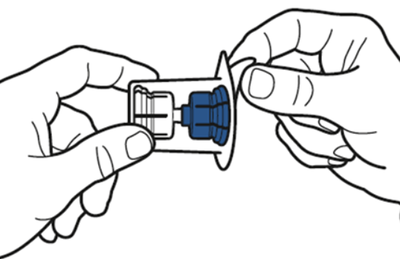
Product Learning Module 4: PCC - Octaplex® Mix2Vial™ transfer set/device
Step 3
Peel Paper Lid off the Mix2Vial™ Transfer Set
Peel the paper lid off the Mix2Vial™ transfer set.
Leave the Mix2Vial™ transfer set in the clear outer packaging to maintain sterility.

Slide 78
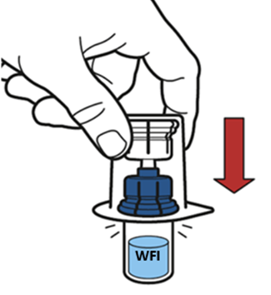
Product Learning Module 4: PCC - Octaplex® Mix2Vial™ transfer set/device
Step 4 Connect Mix2Vial™ Transfer Set to Solvent Bottle
Place the solvent (WFI) bottle on a flat surface and hold the bottle steady.
Invert and centre the Mix2Vial™ transfer set in its clear outer packaging over the solvent (WFI) bottle.
In one smooth motion, push the blue spike part of the Mix2Vial™ transfer set straight down through the rubber stopper of the solvent (WFI) bottle.

Slide 79
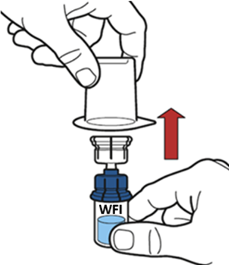
Product Learning Module 4: PCC - Octaplex® Mix2Vial™ transfer set/device
Step 5 Remove Mix2Vial™ Transfer Set Clear Blister Packaging
Securely hold the solvent (WFI) bottle and cautiously remove the clear outer packaging from Mix2Vial™ transfer set.
Ensure the Mix2Vial™ transfer set remains firmly attached to the solvent (WFI) bottle.

Slide 80
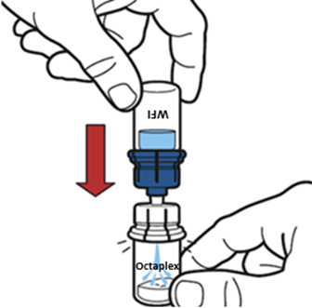
Product Learning Module 4: PCC - Octaplex® Mix2Vial™ transfer set/device
Step 6 Add Solvent to Octaplex® Powder Bottle
While holding the Octaplex® powder bottle steady on a firm flat surface, invert the solvent (WFI) bottle (with the Mix2Vial™ transfer set attached) and firmly push the transparent plastic cannula end of the Mix2Vial™ transfer set through the stopper of the Octaplex® powder bottle.
The transparent plastic cannula will snap into place.
Maintain downward pressure as the vacuum draws the solvent (WFI) into the Octaplex® powder bottle.

Slide 81
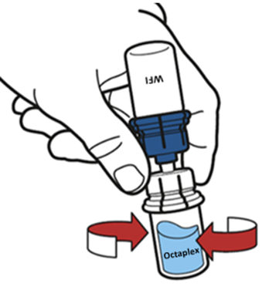
Product Learning Module 4: PCC - Octaplex® Mix2Vial™ transfer set/device
Step 7 Gently Swirl to Dissolve
With solvent (WFI) and Octaplex® bottles still attached, gently and slowly swirl/rotate the Octaplex® bottle until the product is fully dissolved.
Do not shake.

Slide 82
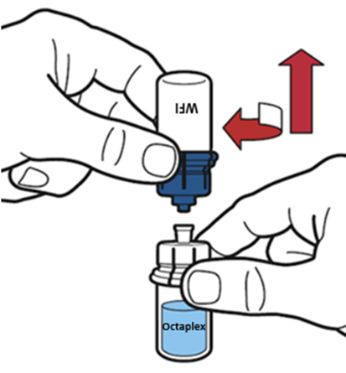
Product Learning Module 4: PCC - Octaplex® Mix2Vial™ transfer set/device
Step 8 Separate Mix2Vial™ Transfer Set; Discard the Blue part with the Empty Solvent Bottle
With one hand, firmly hold the transparent (product side) part and with the other hand, firmly hold the blue (WFI side) part of the Mix2Vial™ transfer set.
Unscrew (turn counterclockwise) the Mix2Vial™ transfer set into two separate pieces with the bottles still attached.
Discard the blue part of the Mix2Vial™ transfer set and the empty solvent (WFI) bottle.
The transparent part of the Mix2Vial™ transfer set must remain attached to the Octaplex® bottle because it includes the filter.

Slide 83
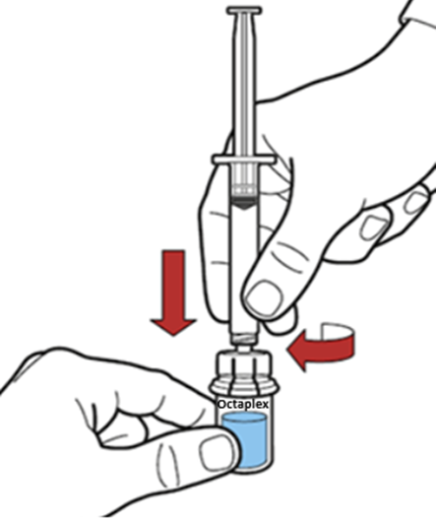
Product Learning Module 4: PCC - Octaplex® Mix2Vial™ transfer set/device
Step 9 Draw Air into syringe. Connect syringe to transparent part of Mix2Vial™ set/Octaplex® bottle. Slowly Inject Air.
Draw air into a sterile syringe (appropriate size, depending on the dose of Octaplex® that is being reconstituted).
Keeping the Octaplex® bottle upright, connect (by turning clockwise) the syringe to the transparent part of the Mix2Vial™ transfer set (which is attached to the reconstituted Octaplex® bottle).
Slowly inject air into the Octaplex® bottle.

Slide 84
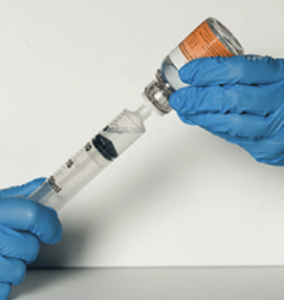
Product Learning Module 4: PCC - Octaplex® Mix2Vial™ transfer set/device
Step 10 Withdraw Octaplex® & Prepare for Administration
Invert the syringe-Octaplex® bottle and withdraw the Octaplex® through the filter of the transparent part of the Mix2Vial™ transfer set into the syringe.
After the Octaplex® has been transferred into the syringe, firmly hold the barrel of the syringe (keeping the barrel directed downwards) and detach (turn counterclockwise) the Mix2Vial™ transfer set and empty bottle from the syringe.
Transfer the Octaplex® from the syringe to a sterile administration bag.
Visually inspect the product; it should be colourless to slightly blue, not cloudy and no deposits noted.
Complete product label and apply to the sterile administration bag.
Octaplex® is ready for administration.
Discard bottle, transparent part of the Mix2Vial™ transfer set, syringe.

Slide 85
Product Learning Module 4: PCC - Octaplex® Mix2Vial™ transfer set/device Reconstitution Summary Steps 1 to 6
Check Expiry Date & Temperature: Verify acceptable expiry date. Both the powder & solvent must be at room temperature.
Remove Caps, Clean Rubber Stopper of Powder & Solvent Bottles: Use an alcohol swab, let dry.
Peel Paper Lid off the Mix2Vial™ Transfer Set: Peel off the paper lid from the Mix2Vial™ transfer set; keep it in the clear blister package.
Connect Mix2Vial™ Transfer Set to Solvent Bottle: Place the solvent (WFI) bottle on a flat surface, hold it steady. Invert & center the Mix2Vial™ set (blue end) over the solvent (WFI) bottle, then push the blue spike down through the stopper of the bottle.
Remove Mix2Vial™ Transfer Set Clear Blister Packaging: Securely hold the solvent (WFI) bottle & pull upwards to remove the clear blister package from the Mix2Vial™ set.
Add Solvent to Octaplex® Powder Bottle: Hold the Octaplex® powder bottle on a flat surface. Invert the solvent (WFI) bottle & push the transparent spike of the Mix2Vial™ set straight down through the stopper of the powder bottle. Maintain downward pressure as the vacuum draws the solvent (WFI) into the powder bottle.

Slide 86
Product Learning Module 4: PCC - Octaplex® Mix2Vial™ transfer set/device Reconstitution Summary Steps 7 to 10
7. Gently Swirl to Dissolve: With the bottles connected via the Mix2Vial™ transfer set, gently swirl/rotate the Octaplex® powder bottle until fully dissolved.
8. Separate Mix2Vial™ Transfer Set; Discard the Blue part with the Empty Solvent Bottle: Unscrew (turn counterclockwise) the Mix2Vial™ transfer set into two separate parts (blue & transparent), carefully keeping the solvent (WFI) & powder bottles attached. Discard the Mix2Vial™ set blue part & empty solvent (WFI) bottle.
9. Draw Air into syringe. Connect syringe to transparent part of Mix2Vial™ set/Octaplex® bottle. Slowly Inject Air: Draw air into sterile syringe (appropriate size, depending on the Octaplex® dose). Connect the syringe to the transparent part of the Mix2Vial™ set that is attached to the upright Octaplex® bottle & slowly inject the air.
10. Withdraw Octaplex® & Prepare for Administration: Keep the plunger of the syringe pressed in & invert the syringe-Octaplex® bottle. Withdraw reconstituted Octaplex® through the transparent part of the Mix2Vial™ set (contains the filter) into the syringe by slowly pulling the plunger back. Firmly hold the barrel of the syringe (keeping the plunger directed downwards) & detach (turn counterclockwise) the Mix2Vial™ transfer set & empty bottle from the syringe. Transfer to sterile administration bag, visually inspect, & label the product.

Slide 87
Product Learning Module 4: PCC - Octaplex®
Administration Notes (1)
Octaplex® is available as 500 IU in 20 mL bottle and 1000 IU in 40 mL bottle. Carefully review the product provided from TML and the prescriber’s order. More than 1 bottle may be required to provide the dose that was ordered. As required, reconstituted Octaplex® from additional bottles may be added to the same sterile administration bag (pooled).
Following reconstitution, Octaplex® should be used immediately. Octaplex® can be stored for up to 8 hours at +2°C to +25°C, provided the sterility of the stored product is maintained. If stored, Octaplex® should be protected from light.
Reconstituted solution is colourless to slightly blue. Do not administer if cloudy or deposits are observed.
Administer at room temperature.
Do not further dilute in any IV solutions. Do not mix with any other medicinal products.
Octaplex® is compatible with 0.9 % sodium chloride (NaCl) and 5 % dextrose in water.
Administer only intravenously via a separate injection/infusion line. For infusion, use a standard IV infusion set (has been filtered as part of reconstitution procedure).

Slide 88
Product Learning Module 4: PCC - Octaplex®
Administration Notes (2)
Flush the IV site with 0.9 % NaCl flush syringe prior to and following administration.
NOTE: PCC is CONTRAINDICATED in patients with heparin-induced thrombocytopenia (HIT) or with known allergies to heparin (Octaplex® contains heparin).
Monitoring blood coagulation with appropriate coagulation assays (plasma levels of individual coagulation factors, or global tests of prothrombin complex levels [prothrombin time, INR]) before and during treatment is recommended.
Indication / Rate
Treatment of bleeding and perioperative prophylaxis of bleeding in acquired deficiency of the prothrombin complex coagulation factors (factors II, VII, IX and X). For example, deficiency caused by treatment with vitamin K antagonists, or in case of overdose of vitamin K antagonists, when rapid correction of the deficiency is required (life threatening bleeding or emergency surgical interventions).
Recommended initial infusion rate 1 mL per minute (60 mL/hour) followed by 2-3 mL per minute (120-180 mL/hour), if appropriate.

Slide 89
Octaplex® Reconstitution Nextaro® transfer device

Slide 90
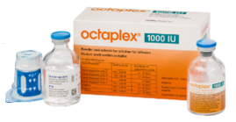
Product Learning Module 4: PCC - Octaplex® Nextaro® transfer device
REMINDER: Only reconstitute when ready to administer.
Octaplex® is available as 500 IU in 20 mL bottle/vial and 1000 IU in 40 mL bottle/vial; reconstituted with 20 mL and 40 mL, respectively, of solvent (water for injection, WFI).
Use appropriate aseptic technique.
Single use only.
TML will provide product label(s) and kit(s) containing: Nextaro® transfer device, solvent (WFI) bottle, Octaplex® powder bottle.
Also required: alcohol swabs, syringe (appropriate size, depending on dose), transfer needles, sterile administration bag.

Slide 91
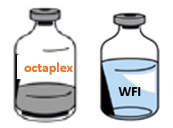
Product Learning Module 4: PCC - Octaplex® Nextaro® transfer device
Step 1 Check Date Expiry & Temperature
Verify product expiry date (on the kit packaging and the bottles) is acceptable.
Ensure the bottles of both the powder and the solvent (WFI) are at room temperature.
During reconstitution, room temperature should be maintained.
Room temperature augments the product powder dissolving.

Slide 92
Product Learning Module 4: PCC - Octaplex® Nextaro® transfer device
Step 2 Remove Caps, Clean Rubber Stopper of Powder & Solvent Bottles
Remove the cap from both the powder and the solvent (WFI) bottles.
Using a circular motion, clean the exposed central part of the rubber stopper of both bottles with an alcohol swab.
Allow the stoppers of the bottles to dry.

Slide 93
Product Learning Module 4: PCC - Octaplex® Nextaro® transfer device
Step 3 Open Nextaro® Transfer Device
Peel off the paper lid of the Nextaro® transfer device.
Leave the Nextaro® device in the clear outer packaging to maintain sterility.
Avoid touching the blue spike to maintain sterility.

Slide 94
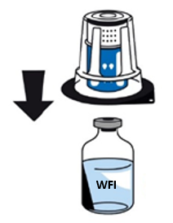
Product Learning Module 4: PCC - Octaplex® Nextaro® transfer device
Step 4 Attach Nextaro® Transfer Device to Solvent Bottle
Firmly hold the solvent (WFI) bottle on a flat surface.
With the Nextaro® device in its outer package, align the blue part on top of the solvent (WFI) bottle.
Firmly press straight down until it snaps into place on the solvent (WFI) bottle. While attaching, do not use a twisting motion.
The Nextaro® transfer device must be attached to the solvent (WFI) bottle first, and then to the Octaplex® powder bottle [to prevent loss of vacuum and failure of the solvent (WFI) to transfer].

Slide 95

Product Learning Module 4: PCC - Octaplex® Nextaro® transfer device
Step 5 Expose White Part of Nextaro® Transfer Device
Firmly hold the solvent (WFI) bottle. Carefully remove the clear outer packaging of the Nextaro® device by pulling vertically upwards.
Ensure the Nextaro® device remains firmly attached to the solvent (WFI) bottle.
Do not touch the exposed white part of the Nextaro® device to maintain sterility.

Slide 96

Product Learning Module 4: PCC - Octaplex® Nextaro® transfer device
Step 6 Connect Solvent Bottle/Nextaro® Transfer Device to the Powder Bottle
With one hand, hold the Octaplex® powder bottle on a flat surface.
With the other hand, invert the solvent (WFI) bottle/Nextaro® device, aligning the white part of the Nextaro® device on top of the Octaplex® powder bottle.
Firmly press straight down until the white part of the Nextaro® device snaps into place on the Octaplex® powder bottle. While attaching, do not use a twisting motion.
The solvent (WFI) will automatically flow into the Octaplex® powder bottle.

Slide 97

Product Learning Module 4: PCC - Octaplex® Nextaro® transfer device
Step 7 Gently Swirl Octaplex® to Dissolve
When the solvent (WFI) has been completely transferred, gently and slowly swirl/rotate the Octaplex® bottle [with solvent (WFI) bottle still attached] until the powder is completely dissolved. Octaplex® dissolves quickly.
Do not shake the bottle as this leads to foam forming.

Slide 98

Product Learning Module 4: PCC - Octaplex® Nextaro® transfer device
Step 8 Unscrew Nextaro® Transfer Device; Discard Blue Part & Empty Solvent Bottle
Firmly hold the Octaplex® bottle with one hand.
With the other hand, grasp the blue part of the Nextaro® device; turn counterclockwise to unscrew the device into two separate pieces with the bottles still attached to the respective Nextaro® device parts.
Discard the blue part of the Nextaro® device and the empty solvent (WFI) bottle.
The white part of the Nextaro® device must remain attached to the Octaplex® bottle because it includes the filter.
Do not touch the luer lock connector on the white part of the Nextaro® device to maintain sterility.

Slide 99

Product Learning Module 4: PCC - Octaplex® Nextaro® transfer device
Step 9 Draw Air into Syringe; Connect Syringe to Nextaro® device/Octaplex® bottle; Slowly Inject Air.
Draw air into a sterile syringe (appropriate size, depending on the dose of Octaplex® that is being reconstituted).
Keeping the Octaplex® bottle upright, carefully connect (by turning clockwise) the syringe to the luer lock connector on the white part of the Nextaro® device that is on the Octaplex® bottle.
Slowly inject air from the syringe into the Octaplex® bottle.

Slide 100

Product Learning Module 4: PCC - Octaplex® Nextaro® transfer device
Step 10 Withdraw Octaplex® & Prepare for Administration
Invert the syringe/white part of Nextaro® device/Octaplex® bottle and withdraw the Octaplex® solution through the white part of the Nextaro® device (contains the filter) into the syringe.
Firmly hold the barrel of the filled syringe (keeping the plunger directed downwards) and detach the white part of Nextaro® device/empty Octaplex® bottle from the syringe.
Transfer the Octaplex® from the syringe to a sterile administration bag.
Visually inspect the product; it should be colourless to slightly blue, not cloudy, and no deposits noted.
Complete product label and apply to sterile administration bag.
Octaplex® is ready for administration.
Discard the white part of Nextaro® device/empty Octaplex® bottle, syringe.

Slide 101
Product Learning Module 4: PCC - Octaplex® Nextaro® transfer device Reconstitution Summary Steps 1 to 5
Check Expiry Date & Temperature: Verify acceptable expiry date. Both the powder & solvent must be at room temperature.
Remove Caps, Clean Rubber Stopper of Powder & Solvent Bottles: Use an alcohol swab, let dry.
Open Nextaro® Transfer Device: Remove the paper lid from the Nextaro® device. For sterility, keep it in its clear outer packaging & do not touch the blue spike.
Attach Nextaro® Transfer Device to Solvent Bottle: Firmly hold the solvent (WFI) bottle on a flat surface. With the Nextaro® device in its outer package, align the blue part on top of the solvent (WFI) bottle. Firmly press straight down until it snaps into place on the solvent bottle; do not use a twisting motion.
Expose White Part of Nextaro® Transfer Device: Maintain sterility & carefully remove the Nextaro® device outer packaging by pulling vertically upwards. Do not touch the exposed white part of the Nextaro® device.

Slide 102
Product Learning Module 4: PCC - Octaplex® Nextaro® transfer device Reconstitution Summary Steps 6 to 8
6. Connect Solvent Bottle/Nextaro® Transfer Device to the Powder Bottle: Invert the solvent (WFI) bottle/Nextaro® device, aligning the white part of the Nextaro® device on top of the Octaplex® powder bottle. Firmly press straight down until the white part of the Nextaro® device snaps into place; do not use a twisting motion. Solvent (WFI) will automatically flow into the Octaplex® powder bottle. 7. Gently Swirl Octaplex® to Dissolve: Gently swirl the Octaplex® powder bottle [with the solvent (WFI) bottle still attached] until the powder is completely dissolved. Do not shake. 8. Unscrew Nextaro® Transfer Device; Discard Blue Part & Empty Solvent Bottle: Firmly hold the Octaplex® bottle. Grasp the blue part of the Nextaro® device; turn counterclockwise to unscrew the device into two separate pieces with the bottles still attached. Discard the blue part of the Nextaro® device & empty solvent (WFI) bottle.

Slide 103
Product Learning Module 4: PCC - Octaplex® Nextaro® transfer device Reconstitution Summary Steps 9 to 10
9. Draw Air into Syringe; Connect Syringe to Nextaro® device/Octaplex® bottle; Slowly Inject Air: Draw air into a sterile syringe (appropriate size, depending on the Octaplex® dose). Keeping the Octaplex® bottle upright, connect (turn clockwise) the syringe to the luer lock connector on the white part of the Nextaro® device that is on the Octaplex® bottle. Slowly inject the air.
10. Withdraw Octaplex® & Prepare for Administration: Withdraw reconstituted Octaplex® through the white part of the Nextaro® device (contains the filter) into the syringe. Firmly hold the barrel of the syringe (keeping the plunger directed downwards) & detach the white part of Nextaro® device/empty Octaplex® bottle from the syringe. Transfer to sterile administration bag, visually inspect, & label the product.

Slide 104
Product Learning Module 4: PCC - Octaplex®
Administration Notes (1)
Octaplex® is available as 500 IU in 20 mL bottle and 1000 IU in 40 mL bottle. Carefully review the product provided from TML and the prescriber’s order. More than 1 bottle may be required to provide the dose that was ordered. As required, reconstituted Octaplex® from additional bottles may be added to the same sterile administration bag (pooled).
Following reconstitution, Octaplex® should be used immediately. Octaplex® can be stored for up to 8 hours at +2°C to +25°C, provided the sterility of the stored product is maintained. If stored, Octaplex® should be protected from light.
Reconstituted solution is colourless to slightly blue. Do not administer if cloudy or deposits are observed.
Administer at room temperature.
Do not further dilute in any IV solutions. Do not mix with any other medicinal products.
Octaplex® is compatible with 0.9 % sodium chloride (NaCl) and 5 % dextrose in water.
Administer only intravenously via a separate injection/infusion line. For infusion, use a standard IV infusion set (has been filtered as part of reconstitution procedure).

Slide 105
Product Learning Module 4: PCC - Octaplex®
Administration Notes (2)
Flush the IV site with 0.9 % NaCl flush syringe prior to and following administration.
NOTE: PCC is CONTRAINDICATED in patients with heparin-induced thrombocytopenia (HIT) or with known allergies to heparin (Octaplex® contains heparin).
Monitoring blood coagulation with appropriate coagulation assays (plasma levels of individual coagulation factors, or global tests of prothrombin complex levels [prothrombin time, INR]) before and during treatment is recommended.
Indication / Rate
Treatment of bleeding and perioperative prophylaxis of bleeding in acquired deficiency of the prothrombin complex coagulation factors (factors II, VII, IX and X). For example, deficiency caused by treatment with vitamin K antagonists, or in case of overdose of vitamin K antagonists, when rapid correction of the deficiency is required (life threatening bleeding or emergency surgical interventions).
Recommended initial infusion rate 1 mL per minute (60 mL/hour) followed by 2-3 mL per minute (120-180 mL/hour), if appropriate.

Slide 106
Product Learning Modules Supplementary Information - FC Indication
A. As per Product Monographs
B. Bloody Easy 5.1 handbook
“Major or massive hemorrhage from surgery or trauma when fibrinogen <1.5 g/L.”
“Acute phase of acute promyelocytic leukemia with fibrinogen <1.5 g/L.”
“Hemorrhage after cardiac surgery or peripartum with fibrinogen <2.0 g/L.”
“Intracranial hemorrhage secondary to Tissue Plasminogen Activator treatment with fibrinogen <2.0 g/L.”
Lab test: Clauss fibrinogen assay, normal fibrinogen 1.5 – 4 g/L.
C. National Advisory Committee on Blood and Blood Products
“FC in the setting of acquired hypofibrinogenemia plays an important role in the management of massive bleeding post cardiac surgery, trauma, and obstetrical hemorrhage among others.”
“Both fibrinogen concentrates appear to have similar efficacy in improving clot firmness in a dilutional hypofibrinogenemia model in vitro.”

Slide 107
Product Learning Modules Supplementary Information – PCC Indication
A. As per Product Monographs
B. Bloody Easy 5.1 handbook
“Reversal of anti-Xa inhibitors: PCC at a dose of 2,000 IU (repeated in 1 hour if hemostasis is not achieved) is being used across Canada. Data to support its use is limited …”
C. National Advisory Committee on Blood and Blood Products
Treatment of bleeding in patients receiving direct FXa inhibitor anticoagulants
“PCC should only be considered in patients with severe or life-threatening bleeding.”
“The optimal dosing strategy is uncertain with 2000 IU (fixed dose) or 25-50 IU/kg (to a maximum of 3000 IU) being the most common.”
NAC also lists some unique patient scenarios (e.g., if plasma is refused but human plasma-derived protein products are accepted).

Slide 108

Product Learning Modules Supplementary Information – Provincial Massive Hemorrhage Protocol, Statement 37 PCC & FC Indication - Hospitals unable to issue plasma for massive hemorrhage protocol

Slide 109
Documentation Learning Modules
This section outlines the documentation responsibilities of the health care professional (HCP) reconstituting FC or PCC outside of TML. These requirements are guided by Canadian Transfusion Medicine standards. The information can be recorded in various sections of the patient’s health record and in paper-based and/or electronic formats.
The documentation learning modules for reconstituting FC or PCC outside of TML include:
Module 5: Product Label
Module 6: Transfusion Record

Slide 110
Documentation Learning Module 5: Product Label (1)
TM Standards define required elements for the label affixed to blood products. TM Standards also identify requirements for the label affixed to modified (e.g., reconstituted, pooled) blood products.
However, TM Standards do not explicitly state labelling parameters for blood products reconstituted and pooled outside of TML. Some interpretation is necessary.
Always refer to your hospital’s specific policies.

Slide 111
Documentation Learning Module 5: Product Label (2)
TML provides labelling for products reconstituted outside of the laboratory. This may include several labels, with one label corresponding to each product kit/powder bottle issued. Alternatively, one label that includes the lot number(s) of all product kits/powder bottles issued for that patient dose may be provided. Complete all labelling as provided by TML.
Some TML label details may be pre-populated or manual entry (must be clear and legible) of all information may be necessary.
The TML label must be compared to the original manufacturer’s product labelling, with no discrepancy identified. Validate/enter the information very carefully as it will be used for the pre-transfusion checks and if a transfusion reaction occurs (vein [donor] to vein [recipient] traceability).

Slide 112


Documentation Learning Module 5: Product Label (3) Example FC Label (i)
Each outlines details of product label required elements.
Patient’s first & last name
Patient’s unique hospital identification number
Type of blood product (if more than one brand is available at the hospital, brand name is required for brand specific reconstitution & administration details)
Lot/unique blood product identification number (this number is found on the product packaging as well as the product powder bottle); for the dose ordered, products from the same manufacturer with varying lot numbers may be combined or pooled
NOTE: The LOT NUMBER is fictitious for purposes of this example. Actual LOT NUMBER configurations: Fibryga® & Octaplex® 1 letter, 3 numbers, 1 letter, 4 numbers RiaSTAP® & Beriplex® letter P, 9 numbers
Notes:
Per CSTM Standards 5.1.1.6 – Traceability 5.6.1 Modified Blood 5.6.2 – Labelling 5.6.2.3 – Modified blood label
5.8 Issuing 5.8.2.6 Issuing – Product Label
5.9.6.2 – Transfusion documentation in health record

Slide 113
Documentation Learning Module 5: Product Label (4) Example FC Label (ii)
Each outlines details of product label required elements.
Reconstituted/pooled modifications (if reconstituted bottles of product were not combined in one sterile administration bag, cross out pooled) performed by: HCP responsible is identified (name/signature/ hospital ID number)
Dose/volume of the product (verify as per order & per reconstitution procedure).
Date & time of reconstitution is required to determine expiry
Expiry date & time must be stated (in this example, the hospital specific policy for expiry is 4 hours from time of reconstitution)
Name of the hospital/facility where the modification was performed.
Notes:
Per CSTM Standards 5.1.1.6 – Traceability 5.6.1 Modified Blood 5.6.2 – Labelling 5.6.2.3 – Modified blood label
5.8 Issuing 5.8.2.6 Issuing – Product Label
5.9.6.2 – Transfusion documentation in health record

Slide 114


Documentation Learning Module 5: Product Label (5) Example FC Label (iii)
Each outlines details of product label information that some hospitals may include (standard fields for all labels). The fields listed below are not mandatory for FC or PCC. ALWAYS REFER TO YOUR HOSPTIAL’S SPECIFIC POLICIES.
Patient ABO/Rh blood groups are not relevant for blood product transfusion. This field may be blank.
The date & time of issue must be readily available to the transfusionist. Hospitals may include this information on the product label or the transfusion record or both. In this example it is on the label & the HCP responsible is identified (name/signature/hospital ID number).
Patient location may be helpful but is not required.
Administration barcode may be included by hospitals with electronic health record documentation systems.
Notes:
Per CSTM Standards 5.1.1.6 – Traceability 5.6.1 Modified Blood 5.6.2 – Labelling 5.6.2.3 – Modified blood label
5.8 Issuing 5.8.2.6 Issuing – Product Label
5.9.6.2 – Transfusion documentation in health record

Slide 115
Documentation Learning Module 5: Product Label (6) Example FC Label (iv)
Each outlines details of product label information that some hospitals may include (standard fields for all labels). The fields listed below are not mandatory for FC or PCC. ALWAYS REFER TO YOUR HOSPTIAL’S SPECIFIC POLICIES.
Checked by is not required but may be included by some hospitals
Hung by is not required but may be included by some hospitals
Start date/time is not required but may be included by some hospitals
Stop date/time is not required but may be included by some hospitals.
Notes:
Per CSTM Standards 5.1.1.6 – Traceability 5.6.1 Modified Blood 5.6.2 – Labelling 5.6.2.3 – Modified blood label
5.8 Issuing 5.8.2.6 Issuing – Product Label
5.9.6.2 – Transfusion documentation in health record

Slide 116
Documentation Learning Module 6: Transfusion Record (1)
TM Standards require the name of the HCP who prepared (reconstituted, pooled) the product for administration as well as the date and time of preparation are documented on the patient’s health record.
TML provides a Transfusion Record (chart label, transfusion form) for products reconstituted outside of the laboratory. This may include several Transfusion Records, with one record corresponding to each product kit/powder bottle issued. Alternatively, one Transfusion Record that includes the lot number(s) of all product kits/powder bottles issued for that patient dose may be provided. The Transfusion Record(s) must incorporate/document each bottle of product that was reconstituted & administered to the patient. Complete the Transfusion Record or Records as provided by TML.
Always refer to your hospital’s specific policies.

Slide 117
Documentation Learning Module 6: Transfusion Record (2)
The Transfusion Record(s) may be paper-based and/or electronic format.
Some Transfusion Record details may be pre-populated or manual entry (must be clear and legible) of all information may be necessary.
Validate/enter the information very carefully as it is part of the patient’s health record and may be referenced if a transfusion reaction occurs or in the event of a future manufacturer product recall (vein [donor] to vein [recipient] traceability).

Slide 118


Documentation Learning Module 6: Transfusion Record (3) Example paper FC Transfusion Record (i) Each outlines details of Transfusion Record required elements pertaining specifically to reconstitution.
In this example, MRN # is the patient’s unique hospital identification number
Patient’s first & last name
Product: if more than one brand is available at the hospital, brand name is required for brand specific reconstitution & administration details.
Lot number is found on the product label as well as on the original product packaging and vial (for the dose ordered, products from the same manufacturer with varying lot numbers may be combined or pooled)
NOTE: The LOT NUMBER is fictitious for purposes of this example. Actual LOT NUMBER configurations: Fibryga® & Octaplex® 1 letter, 3 numbers, 1 letter, 4 numbers RiaSTAP® & Beriplex® letter P, 9 numbers

Slide 119
Documentation Learning Module 6: Transfusion Record (4) Example paper FC Transfusion Record (ii) Each outlines details of Transfusion Record required elements pertaining specifically to reconstitution.
Reconstituted/pooled: modifications performed must be documented (if reconstituted vials of product were not combined in one sterile administration bag, cross out pooled)
Dose and volume of the product (verify as per order & per reconstitution procedure)
Date & time of reconstitution must be documented and informs product expiry
The name/signature/hospital ID number of the HCP who prepared (reconstituted, pooled) the product for administration must be documented.
Complete mandatory transfusion documentation requirements as per hospital specific policy

Slide 120
Reconstitution of FC & PCC Outside of TML Summary (1)
Confirm the dose per bottle (vial) and the dose the prescriber ordered. More than 1 bottle may be required to provide the dose that was ordered.
Verify the product expiry date is acceptable (noted on product solvent and powder bottles as well as the manufacturer kit packaging).
Use appropriate aseptic technique (sterile elements, handwashing, gloves, designated clean area specified for reconstitution of blood products).
Product and kit are for single-use only.
Precisely follow the details of the manufacturer's stepwise instructions.
Use only the solvent provided in the product kit for reconstitution.
Ensure both the powder and the solvent (water for injection) are at room temperature. During reconstitution, room temperature should be maintained. Room temperature augments the product powder dissolving.

Slide 121
Reconstitution of FC & PCC Outside of TML Summary (2)
After the solvent (water for injection) has been added to the powder bottle, gently and slowly swirl or rotate the bottle to completely dissolve the product powder.
A final step of the reconstitution procedure is to withdraw the reconstituted product from its bottle through a filter (included in the device provided by the manufacturer).
Reconstituted product from additional bottles of the same brand may be added to the same sterile administration bag (pooled). Pooling of reconstituted product of the same brand with varying lot numbers is acceptable.
Do not use reconstituted products that are cloudy or have deposits.
Do not further dilute in any IV solutions. Do not mix with any other medicinal products.
Administer only intravenously via a separate injection/infusion line. For infusion, use a standard IV infusion set (has been filtered as part of reconstitution procedure).
Flush the IV site with 0.9 % sodium chloride flush syringe(s) prior to and following administration.

Slide 122
Reconstitution of FC & PCC Outside of TML Summary (3)
Complete the product label(s) (provided by TML) by validating the lot number on the powder bottle is identical to the lot number listed on the product label.
As per your hospital policy, document the expiry time of the reconstituted product on the product label.
Complete the transfusion record(s) (provided by TML) by validating the lot number on the powder bottle is identical to the lot number listed on the transfusion record. Add the name/signature/hospital ID number of the person who prepared the product and the date and time of reconstitution.
These products contain no preservatives; ideally administer immediately once reconstitution steps are completed, and the product is transferred from the bottle to a sterile administration bag. If the product is not administered immediately, follow manufacturer’s guidelines and your hospital policy for storage following reconstitution.

Slide 123
Resources
CSL Behring Healthcare Professional Hub. Healthcare professional hub. RiaSTAP® Fibrinogen Concentrate (Human) and Beriplex P/N® Human Prothrombin Complex [Internet]. Ottawa (CA): CSL Behring Canada; 2020 [cited 2025 Aug 19]. Available from: https://hcp.cslbehring.ca/ (Note: You must register for access, then click on “Information and Tools” for several resource options)
Octapharma Canada Incorporated. Fibryga® virtual toolkit [Internet]. Toronto (CA): Octapharma; 2021 [cited 2025 Aug 19]. Available from: https://fibrygaresources.ca/fibryga-virtual-tool-kit/
Octapharma Products. Our product portfolio Octaplex® [Internet]. Toronto (CA): Octapharma; 2022 [cited 2025 Aug 19]. Available from: https://www.octapharma.com/products/product-overview/octaplex A quick reference PDF of the eLearning content is available: Ontario Regional Blood Coordinating Network. Reconstitution of Fibrinogen Concentrate (FC) and Prothrombin Complex Concentrate (PCC) Outside of the Transfusion Medicine Laboratory (TML) Toronto ON; Ontario Regional Blood Coordinating Network; 2025 [cited 2025 Oct 1]. Available from: https://transfusionontario.org/en/category/bloody-easy-e-tools-publications/reconstitution-outside-tml/

Slide 124
Glossary & Abbreviations (1)
Blood Component: a therapeutic part of blood planned for transfusion (e.g., red blood cells, platelets, granulocytes, plasma, cryoprecipitate).
Blood Product: a therapeutic product derived from human blood plasma and produced by a manufacturing process, also referred to as plasma protein product (e.g., albumin, coagulation products, factor concentrates, immunoglobulins).
Fibrinogen Concentrate (FC): is a manufactured source of human fibrinogen (fibrinogen has a critical role in hemostasis).
Health Care Professional (HCP): a person associated with a specialty or a discipline, who is qualified and allowed by regulatory bodies to provide a healthcare service to a patient.
Issue: release of a blood component or blood product from TML (temperature-controlled environment) to the clinical area, synonymous with dispense.
Massive Hemorrhage Protocol (MHP): a protocol to guide management of a massively bleeding patient.
Modification: manipulations/procedures performed by TM to blood components or blood products required to meet patient specific transfusion needs and/or to facilitate transfusion. Includes (Health Canada regulations defines irradiating, pooling and washing as “transformations”): a) aliquoting (splitting) b) irradiating c) pooling d) removing supernatant (concentrating) e) thawing f) washing g) reconstituting (blood products).
Pooled: for this learning, refers to the act of combining two or more bottles of reconstituted blood product.
Prescriber: for this learning, refers to health care professionals who are authorized to order transfusion of blood components and blood products (physicians, physician assistants, nurse practitioners, midwives, dentists).

Slide 125
Glossary & Abbreviations (2)
Prothrombin complex concentrate (PCC): is a coagulation factor concentrate that contains the vitamin K dependent procoagulant factors (II, VII, IX and X), Protein C and Protein S, and is manufactured with heparin added.
Standard Operating Procedure (SOP): written instructions for a series of steps or tasks, completed to produce a result or product.
Sterile Water for Injection (sWFI): sterile fluid provided in a reconstitution kit
Transfer Device or Transfer Set: equipment provided in a reconstitution kit, used to combine the solvent and powder
Transfusion Medicine (TM): hospital department that performs transfusion-related serological testing and oversees provision of blood components and/or blood products, also known as the Transfusion Service.
Transfusion Medicine Laboratory (TML): hospital laboratory for TM services; also known as the Blood Bank.
Transfusionist: Regulated health care professional who administers a blood transfusion.
Water for Injection (WFI): sterile fluid provided in a reconstitution kit

Slide 126
References (1)
Callum JL, Pinkerton PH, , Lin Y, Cope, S Karkouti K, Lieberman L, Pendergrast JM, Robitaille N, Tinmouth AT, Webert KE. Bloody easy 5.1 blood transfusions, blood alternatives and transfusion reactions a guide to transfusion medicine. 5th ed. Toronto: Ontario Regional Blood Coordinating Network; 2022 [revised 2023; cited 2025 Aug 12]. Available from: https://transfusionontario.org/en/category/bloody-easy-e-tools-publications/bloody-easy-for-healthcare-professionals/
Canadian Blood Services (CBS). Clinical guide to transfusion chapter 5. Concentrates for hemostatic disorders and hereditary angioedema [Internet]. Ottawa (CA); CBS: 2022 May 6 [cited 2025 Aug 12]. Available from: https://professionaleducation.blood.ca/en/print/pdf/node/991031783 Canadian Society for Transfusion Medicine (CA). Standards for hospital transfusion services. Markham ON; 2021 Dec; cited 2025 Aug 12. 110 p. Report No.: Version 5. Available from: http://www.transfusion.ca/Resources/Standards CSL Behring Canada Product List. Beriplex P/N® Human Prothrombin Complex product monograph [Internet]. Ottawa (CA): CSL Behring Canada; 2010 Nov 5 [revised 2019 Oct 23; cited 2025 Aug 19]. Available from: https://labeling.cslbehring.ca/PM/CA/Beriplex-PN/EN/Beriplex-PN-Product-Monograph.pdf
CSL Behring Canada Product List. RiaSTAP™ Fibrinogen Concentrate (Human) product monograph [Internet]. Ottawa (CA): CSL Behring Canada; 2020 Mar 26 [cited 2025 Aug 19]. Available from: http://labeling.cslbehring.ca/PM/CA/RiaSTAP/EN/RiaSTAP-Product-Monograph.pdfL Behring Healthcare Professional Hub CSL Behring Healthcare Professional Hub. Healthcare professional information additional information. RiaSTAP® Fibrinogen Concentrate (Human) [Internet]. Ottawa (CA): CSL Behring Canada; 2020 [cited 2025 Aug 19]. Available from: https://hcp.cslbehring.ca/ (Note: Click on “Products” to register for access, then click on “Information and Tools”) CSL Behring Healthcare Professional Hub. Healthcare professional information videos. RiaSTAP® Fibrinogen Concentrate (Human) [Internet]. Ottawa (CA): CSL Behring Canada; 2020 [cited 2025 Aug 19]. Available from: https://hcp.cslbehring.ca/ (Note: Click on “Products” to register for access, then click on “Information and Tools”)) National Advisory Committee on Blood and Blood Products. Guidelines & recommendations NAC statement on clinical equivalency of select fractionated plasma protein products [Internet]. [Place unknown]: National Advisory Committee on Blood and Blood Products; 2022 Jan 17 [cited 2025 Aug 12]. Available from: https://nacblood.ca/en/resource/nac-statement-clinical-equivalency-select-fractionated-plasma-protein-products National Advisory Committee on Blood and Blood Products. Guidelines & recommendations NAC statement on fibrinogen concentrate use in acquired hypofibrinogenemia [Internet]. [Place unknown]: National Advisory Committee on Blood and Blood Products; 2014 Dec 15 [revised 2025 Feb 26; cited 2025 Aug 12]. Available from: https://nacblood.ca/en/resource/nac-statement-fibrinogen-concentrate-use-acquired-hypofibrinogenemia

Slide 127
References (2)
National Advisory Committee on Blood and Blood Products. Guidelines & recommendations Recommendations for Use of Prothrombin Complex Concentrates in Canada [Internet]. [Place unknown]: National Advisory Committee on Blood and Blood Products; 2008 Sep 16 [2022 Feb 1; cited 2025 Aug 12]. Available from: https://nacblood.ca/en/resource/recommendations-use-prothrombin-complex-concentrates-canada
National Standard of Canada Canadian Standards Association (CA). Blood and blood components. Toronto ON; 2025 Mar; cited 2025 Aug 12. 166 p. Report No.: CAN/CSA-902:25. Available from: https://community.csagroup.org/docs/DOC-126295 (Note: must create a user account for access)
Octapharma Canada Incorporated. Fibryga® virtual toolkit [Internet]. Toronto (CA): Octapharma; 2021 [cited 2025 Aug 19]. Available from: https://fibrygaresources.ca/fibryga-virtual-tool-kit/ Octapharma Our Products in Canada. Fibryga® Human Fibrinogen Concentrate product monograph [Internet]. Toronto (CA): Octapharma; 2017 Jun 7 [revised 2021 Nov 25; cited 2025 Aug 19]. Available from: https://transfusionontario.org/en/fibryga-human-fibrinogen-concentrate-product-monograph/ (Note: includes information for the Octajet® transfer device)
Octapharma Our Products in Canada. Fibryga® Human Fibrinogen Concentrate product monograph [Internet]. Toronto (CA): Octapharma; 2017 Jun 7 [revised 2024 Oct 24; cited 2025 Aug 21]. Available from: https://www.octapharma.ca/api/download/x/cb340082a5/fibryga_en_oct-24-2024.pdf (Note: includes information for the Nextaro® transfer device)
Octapharma Our Products in Canada. Octaplex® Human prothrombin complex concentrate product monograph [Internet]. Toronto (CA): Octapharma; 2017 Oct 24 [cited 2025 Aug 19]. Available from: https://transfusionontario.org/en/octaplex-human-prothrombin-complex-product-monograph/ (Note: includes information for the Mix2Vial™ transfer set) Octapharma Our Products in Canada. Octaplex® Human prothrombin complex concentrate product monograph [Internet]. Toronto (CA): Octapharma; 2007 May 1 [revised 2024 Nov 21; cited 2025 Aug 21]. Available from: https://www.octapharma.ca/api/download/x/44155ff142/octaplex_en_nov-21-2024.pdf (Note: includes information for the Nextaro® transfer device)
Octapharma Products. Our product portfolio Octaplex® [Internet]. Toronto (CA): Octapharma; 2022 [cited 2025 Aug 19]. Available from: https://www.octapharma.com/products/product-overview/octaplex Ontario Regional Blood Coordinating Network. Bloody easy blood administration. version 3. Toronto: Ontario Regional Blood Coordinating Network; 2020 [cited 2025 Aug 12]. 146p. Available from: https://transfusionontario.org/en/category/bloody-easy-e-tools-publications/bloody-easy-blood-administration/ Ontario Regional Blood Coordinating Network. Provincial massive hemorrhage toolkit [Internet]. Toronto ON; Ontario Regional Blood Coordinating Network; 2020 Jul [cited 2025 Aug 12]. Available from: https://transfusionontario.org/wp-content/uploads/2023/02/MHP_Toolkit_v2.pdf Thrombosis Canada. Clinical guides DOACS management of bleeding [Internet]. Whitby ON : Thrombosis Canada; 2024 Aug 8 [cited 2025 Aug 12]. Available from: https://thrombosiscanada.ca/hcp/practice/clinical_guides?language=en-ca&guideID=MANAGEMENTOFBLEEDINGINPATIENTS

Slide 128
Acknowledgements
The Ontario Regional Blood Coordinating Network (ORBCoN) gratefully acknowledges funding support provided by the Ontario Ministry of Health. The views expressed in this presentation are those of the authors and of ORBCoN and do not necessarily reflect those of the Ontario Ministry of Health or the Government of Ontario.
ORBCoN is indebted to Octapharma and CSL Behring for their collaboration and sharing of the graphics utilized in the product modules.
A special note of appreciation to the following hospitals and their staff for their expert review:
Guelph General Hospital, Guelph
Sandra Bakker, MLT, Charge Technologist, Transfusion Medicine.
Health Sciences North, Sudbury
Marvin Jones, MLT, BSc (MLS), Charge Technologist, Transfusion Medicine.
Renee Fillier, RN, MN, CNCC(C), Virtual Critical Care and CCRT Clinician, Critical Care Program.
Joseph Brant Hospital, Burlington
Lynda Gaskin, MLT, Charge Technologist, Transfusion Medicine.
Melany Owens, RN, BScN, MHM, Professional Practice Educator, Emergency Department & Diagnostic Imaging; Assistant Clinical Professor, McMaster University School of Nursing.
Unity Health, Toronto
Lisa Manswell, RN, MN, Transfusion Safety Nurse, St. Michael’s Hospital.

Slide 129
General Disclaimer
The publisher, author(s)/general editor(s) and every person involved in the creation of this resource, whether directly or indirectly, shall not be liable for any loss, injury, claim, liability or damage of any kind resulting from the use of or reliance on any information or material contained in this resource. This resource is intended for information purposes only, without any warranties of any kind. Without limitation, the resource is not intended or designed to constitute or replace medical advice or to be used for diagnosis. If specific information on personal health matters is sought, advice from a physician or other appropriate health professional should be obtained. Any decision involving patient care should be based on the judgement of the attending physician according to the needs and condition of each individual patient. The publisher, author(s)/general editor(s) and every person involved in the creation of this resource disclaim all liability in respect of the results of any actions taken in reliance upon information contained in this resource and for any errors or omissions in the resource. They expressly disclaim liability to any user/reader of the resource.
47

Slide 130

Reconstitution of Fibrinogen Concentrate (FC) and Prothrombin Complex Concentrate (PCC) Outside of the Transfusion Medicine Laboratory (TML)
Email: bertad@mcmaster.ca

