Slide 1
The Elephant in the Transfusionist’s Skill Set: Understanding Compatibility for Transfusion Safety
Donna Berta RN, BScN
Clinical Project Coordinator – Nursing
Ontario Regional Blood Coordinating Network (ORBCoN)
March 27, 2024

Slide 2
Speaker Disclosure
No commercial product conflicts of interest to declare
Transfusion Transmitted Injuries Surveillance System, member Education Committee
Using Blood Wisely initiative, member nursing education development
Canadian Society of Transfusion Medicine, member Standards Committee

Slide 3
Pre Transfusion Knowledge Question 1
Paramedics arrive in ED with Emma, a 21-year-old female trauma patient. She is unresponsive, being intubated, unstable & bleeding. Lab tests are pending. Blood, 4 units RBC & 4 units plasma (FP), is ordered.
The safest blood for this patient, Emma is:
Group O, Rh positive RBC and group O FP.
Group O, Rh negative RBC and group O FP.
Group O, Rh positive RBC and group AB FP.
Group O, Rh negative RBC and group AB FP.

Slide 4
Pre Transfusion Knowledge Question 2
An RBC unit crossmatched, compatible is safe for transfusion when:
The ABO antigens on the red blood cells in the unit of blood will not be hemolysed by ABO antibodies in the patient’s plasma.
The ABO antigens on the red blood cells in that unit of blood will be hemolysed by ABO antibodies in the patient’s plasma.
The ABO antibodies on the red blood cells in the unit of blood will not be hemolysed by ABO antigens in the patient’s plasma.
The ABO antibodies on the red blood cells in the unit of blood will be hemolysed by ABO antigens in the patient’s plasma.

Slide 5
The Elephant in the Transfusionist’s Skill Set: Understanding Compatibility for Transfusion Safety
Objectives:
To recognize and understand the antigens & antibodies in the ABO & Rh(D) blood groups, the clinically significant antibodies, and the potential for incompatibility (patient/component).
To increase confidence in this knowledge by evaluating patient cases.
Outline:
Blood Compatibility
ABO Blood Group System
Rh(D) Antigen, Rh Blood Group System
Clinically Significant Antibodies
Patient Cases with Blood Compatibility Check Visual Aid
Take Home Messages/Summary

Slide 6
Blood Compatibility (1)
Transfusionist: responsibility & accountability for confirming blood compatibility.
Refers to the ability of one individual's blood to be transfused safely (without an adverse reaction) into another individual's body.
An incompatible transfusion can lead to hemolysis.
Hemolysis is the destruction of red blood cells & subsequent leakage (hemoglobin) into intravascular (circulation, main blood vessels) or extravascular (reticuloendothelial system) space.
Both immune (antigen-antibody mismatch) and non-immune (thermal, osmotic, or mechanical injury to blood products) mediated hemolytic transfusion reactions can occur.
Most hemolytic transfusion reactions are benign, however life-threatening anemia, coagulopathy & renal failure can ensue.
Notes:
Responsibility refers to the obligation to perform the task or comply with the rule; accountability implies answerability for the outcome of the task or process. Responsibility is imposed whereas accountability is accepted. Responsibility can be partially delegated, but it is impossible to delegate accountability.
Hemolysis is the rupture and subsequent leakage of red blood cells (RBCs) into intravascular (in the circulation) or extravascular (in the reticuloendothelial system) spaces. These reactions can be immune-mediated or non–immune-mediated. Immune hemolytic transfusion reactions occur due to mismatch or incompatibility (ABO, Kell, Duffy) of the recipient with the donor products and are divided into acute versus delayed reactions. Extravascular hemolysis (thermal, osmotic, or mechanical injury to blood products) occurs when an antibody targeting an RBC antigen opsonizes the RBC, which leads to sequestration and phagocytosis by macrophages, dendritic cells, and neutrophils of the reticuloendothelial system, with primary involvement in the liver, spleen, and bone marrow. Macrophage activation also increases the production of proinflammatory cytokines that induce a systemic response, resulting in symptoms such as fever, chills, abdominal flank pain, and back pain. The process at which opsonins (antibodies) bind to the surface of the antigen so that the antigen will be readily identified and engulfed by phagocytes for destruction. [StatPearls]
Extent of hemolytic reaction depends on many variables: antigen immunogenicity (chemical nature, molecular size) & dose (volume and frequency) & the individual’s age, physiological state, capacity to respond) [ISBT book p.59]
Signs & symptoms of an incompatible transfusion include anxiety (the ominous ‘sense of impending doom’), flushing followed by cyanosis, fever, rigors, pain at the infusion site, lumbar spine and flanks, nausea, vomiting and shock. Coagulopathy with diffuse bleeding and renal failure complete the ‘classic’ description [Mollison’s p. 459]
complement activation and result in shock, renal failure, disseminated intravascular coagulopathy (DIC).

Slide 7
Blood Compatibility (2)
An antigen is a substance that can cause an immune system reaction. It is a marker or identifier (name badge) that indicates if a substance is foreign or not foreign (does not belongs or belongs) in your body.
An antibody is a protein that the immune system produces to attack & fight foreign antigens (protector).
Determined by the presence or absence of antigens & antibodies (in the blood to be transfused & the patient’s blood).
Blood group antigens are categorized into blood group systems (July 2023, 45 blood group systems are known) based on genetic origins.
For transfusion, ABO blood group system is most significant, with Rh blood group system, Rh(D) antigen second in importance.
Antigen: on exterior surface of red blood cell
Antibody:
in the plasma
Notes:
ISBT As of July 2023, 45 acknowledged blood group systems which include 362 antigens. Each system signifies a single gene or a cluster of two or more closely linked homologous genes. A homologous gene (or homolog) is a gene inherited in two species from a common ancestor.
An antigen (i.e., ABO carbohydrates on glycoproteins or glycophospholipids) is a substance that can make your body’s immune system react. Think of an antigen as a marker (like a nametag) that identifies a substance in your body as belonging or not belonging
An antibody is a protein produced by your immune system to attack and fight off antigens recognized as foreign. Antibodies are formed following exposure to foreign red cell antigens during transfusion or pregnancy.

Slide 8
ABO Blood Group System (1)
GROUP AB
GROUP A
GROUP B
GROUP O
ABO Antibodies
are naturally acquired, starting at 4 months of age.
If, the antigen is present on the surface of the red blood cells, then the corresponding antibody will NOT be in the plasma.
If, the antigen is NOT present on the surface of the red blood cells, then the corresponding antibody will be in the plasma.
Notes:
ABO antibodies activate complement, cause immediate intravascular red cell destruction, can lead to severe & fatal hemolytic transfusion reactions
A current group & screen test is essential for transfusion of compatible blood components (incompatible [antigen/antibody] transfusion can lead to life threatening acute hemolysis) Test patient sample: presence or absence of A and B antigens on the red blood cells presence or absence of anti-A and anti-B antibodies in the plasma

Slide 9
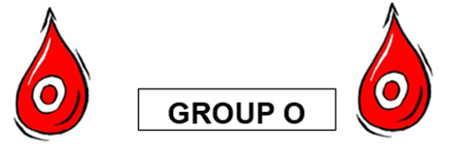
Learning Review 1
For blood group O, no ABO antigens are on the exterior surface of red blood cells. What antibody(ies) will be in the plasma?
Anti-A antibody.
Anti-B antibody.
Both anti-A and anti-B antibodies.
No antibodies.
Notes:
When recipient antibodies target and attack donor RBCs, this is referred to as "major incompatibility." Conversely, when donor antibodies attack recipient RBCs, it is termed "minor incompatibility" because fewer antibodies are involved [StatPearls]

Slide 10
ABO Blood Group System (1)
GROUP AB
GROUP A
GROUP B
GROUP O
ABO Antibodies
are naturally acquired, starting at 4 months of age. If, the antigen is present on the surface of the red blood cells, then the corresponding antibody will NOT be in the plasma.
If, the antigen is NOT present on the surface of the red blood cells, then the corresponding antibody will be in the plasma.
Notes:
ABO antibodies activate complement, cause immediate intravascular red cell destruction, can lead to severe & fatal hemolytic transfusion reactions
A current group & screen test is essential for transfusion of compatible blood components (incompatible [antigen/antibody] transfusion can lead to life threatening acute hemolysis) Test patient sample: presence or absence of A and B antigens on the red blood cells presence or absence of anti-A and anti-B antibodies in the plasma

Slide 11
Learning Review 2
For blood group AB, antigens A and B are on the exterior surface of red blood cells. What antibody(ies) will be in the plasma?
Anti-A antibody.
Anti-B antibody.
Both anti-A and anti-B antibodies.
No antibodies.
Notes:
When recipient antibodies target and attack donor RBCs, this is referred to as "major incompatibility." Conversely, when donor antibodies attack recipient RBCs, it is termed "minor incompatibility" because fewer antibodies are involved [StatPearls]

Slide 12
ABO Blood Group System (1)
GROUP AB
GROUP A
GROUP B
GROUP O
ABO Antibodies
are naturally acquired, starting at 4 months of age. If, the antigen is present on the surface of the red blood cells, then the corresponding antibody will NOT be in the plasma.
If, the antigen is NOT present on the surface of the red blood cells, then the corresponding antibody will be in the plasma.
cause immediate intravascular red blood cell destruction, may lead to severe/fatal hemolysis.
Notes:
ABO antibodies activate complement, cause immediate intravascular red cell destruction, can lead to severe & fatal hemolytic transfusion reactions
A current group & screen test is essential for transfusion of compatible blood components (incompatible [antigen/antibody] transfusion can lead to life threatening acute hemolysis) Test patient sample: presence or absence of A and B antigens on the red blood cells presence or absence of anti-A and anti-B antibodies in the plasma

Slide 13
ABO Blood Group System (2)
Compatibility is determined by the presence or absence of antigens & antibodies (in the blood to be transfused & the patient’s blood).
Red blood cells:
Antigen(s)
Plasma:
Antibody(ies)
Transfusing RBC: ensure the patient’s plasma antibodies will not hemolyze the transfused RBC (the RBC unit’s red blood cells do not have corresponding antigen on their surface).
Transfusing FP: ensure the antibodies in the FP will not hemolyse the patient’s red blood cells (patient’s red blood cells do not have the corresponding antigen on their surface).
Transfused platelets: should be ABO compatible with patient’s red blood cells (platelets are suspended in donor plasma & also contain a few red blood cells). If platelets are in short supply, TML policy re: blood group substitution.
Notes:
When recipient antibodies target and attack donor RBCs, this is referred to as "major incompatibility." Conversely, when donor antibodies attack recipient RBCs, it is termed "minor incompatibility" because fewer antibodies are involved [StatPearls]
BE 5.1 p. 29 Each platelet unit contains less than 10x108 red blood cells.

Slide 14
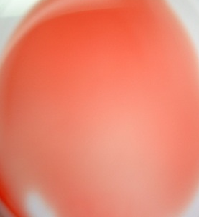
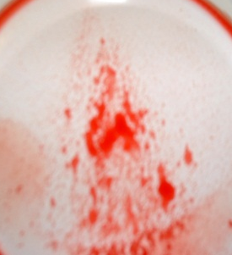
ABO Blood Group System (3)
RBC unit Group A transfused to patient Group A (microscope, schematic)
RBC unit Group B transfused to patient Group A (microscope, schematic)

Slide 15
Rh(D) Antigen, Rh Blood Group System (1)
Rh(D) is clinically the most important of the 54 antigens in the Rh blood group system.
GROUP Rh(D) POSITIVE
GROUP Rh(D) NEGATIVE

Slide 16
Rh(D) Antigen, Rh Blood Group System (2)
Anti-D Antibody
Anti-D antibody is NOT naturally occurring and is NOT in the plasma of:
Rh(D) positive patients
Rh(D) negative patients UNLESS exposed to the D antigen, and then anti-D antibody may be produced.
Rh(D) negative individuals can be exposed to the D antigen (and then may produce anti-D antibody) through:
Transfusion of Rh(D) positive RBC
Transfusion of Rh(D) positive platelets (platelets contain small amounts of red blood cells)
Pregnancy/delivery of an Rh(D) positive fetus
Anti‐D antibody can cause severe immediate or delayed hemolysis.
Rh(D) positive blood should not be transfused to a patient with anti‐D.
Anti-D: most common cause of severe Hemolytic Disease of the Fetus & Newborn (HDFN). Rh immune globulin (RhIG) prophylaxis, used since late1960’s.
Notes:
Rh immune globulin (RhIG) is contains antibodies to Rh antigen D (RhD). It prevents a person’s immune system from recognizing RhD, thus suppressing a potentially fatal immune reaction. RhIG has been in use since the late 1960s

Slide 17
Rh(D) Antigen, Rh Blood Group System (3)
Rh(D) positive patients: can be transfused blood that is Rh(D) positive or Rh(D) negative.
Rh(D) negative patients: ideally should be transfused blood that is Rh(D) negative to avoid producing the anti-D antibody.
Rh(D) negative females of child-bearing age/potential (to avoid producing the anti-D antibody and risk of HDFN) :
should be transfused blood that is Rh(D) negative.
if Rh(D) positive platelets are transfused (re: platelet supply), Rh immunoglobulin (RhIG) is required.
For FP transfusion: Rh(D) blood group is not relevant (plasma has no red blood cells, i.e., no antigens)
Notes:
BE 5.1 p. 17 Female children and people of child-bearing age/potential who are Rh(D) negative should receive Rh immunoglobulin before, after or within 72 hours of receiving an Rh(D) positive
platelet component.
BE 5.1 p. 29 Each platelet unit contains less than 10x108 red blood cells. Each 120 ug of RhIG covers 12 mL whole blood (6 mL RBC) and lasts approximately 21 days.
RhIG is not recommended for males, and females of non-childbearing potential, because risk of immunization from platelets is low (about 1%) and passive anti-D complicates compatibility testing and may delay transfusion

Slide 18
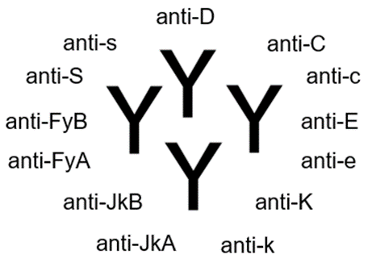
Clinically Significant Antibodies (1)
In addition to antigens A, B, and D human red blood cells have many other antigens on their surface.
If exposed to “foreign” red blood cell antigens via pregnancy or transfusion, antibodies against these antigens may be produced.
Clinically Significant Antibodies: If a patient forms these antibodies, then hemolysis of transfused RBC unit that has the corresponding antigen on the red blood cells can occur.
NOTE: For females of child-bearing potential, providing Kell negative (K-) RBC decreases the incidence of K-immunized pregnancies (and potential HDFN). In Canada this is established practice, except in emergency transfusion scenarios.
Notes:
Clinically significant antibodies can cause hemolysis of red blood cells that have the corresponding antigen, like anti-A, anti-B antibodies. Antibodies formed against antigens M, N, LeA and LeB are usually not clinically significant.
If a patient has anti-M, anti-N, anti-LeA, or anti-LeB and their antibody screen is positive (i.e. the antibody is reacting), TM does a full crossmatch (i.e. the PRBC unit issued is compatible) however, phenotyped units are not necessarily required.

Slide 19
Clinically Significant Antibodies (2)
Group & Screen Test - antibody screen (antibody detection test):
TML tests the serum (plasma part of patient blood sample) to either rule out or identify the clinically significant antibodies.
If all clinically significant antibodies are ruled out, the antibody screen is reported as negative.
If clinically significant antibody(ies) are identified (red blood cell sensitization/alloimmunization), compatible RBC units for patient transfusion must be negative for the corresponding antigen(s). (e.g., anti-c and anti-FyA identified in the plasma of the patient’s blood sample, then RBC units for transfusion must be antigens c- and FyA-).
TML maintains meticulous transfusion history records; they are consistently checked.
Notes:
Red Blood Cell Sensitization:
RBC sensitization occurs when a person is exposed to foreign antigens on erythrocytes (red blood cells) and responds by forming antibodies against these antigens. Red Blood Cell Alloimmunization:
Alloimmunization occurs when a person lacking a specific RBC antigen is exposed to that antigen during transfusion or pregnancy.

Slide 20
Clinically Significant Antibodies (3)
Anamnestic/Recall Response:
Clinically significant antibody levels in the patient’s plasma will decrease over time and may become non-detectable.
The anamnestic/recall response refers to when a second exposure to the same antigen occurs, the antibody response is typically faster, much more sustained & antibody levels are higher.
Anti-JkA and anti-JkB (Kidd blood group system) are notable.
If clinically significant antibody(ies) identified, patient should be counselled, provided “antibody card”; option medical alert bracelet.
For RBC transfusion, when feasible, ask patients/their family (and follow up with TML as indicated).
Have they had previous transfusion?
If so, did they experience any side effects/reactions?

Slide 21
Summary: Blood Compatibility Checks
ABO Blood Groups (if antigen present, then antibody absent; if antigen absent then antibody present; ABO antibodies are naturally acquired, starting at 4 months of age).
Blood Group | Population Frequency | ABO Antigen(s) - red blood cell surface | ABO Antibody(ies) - plasma
O | 45% | none | anti-A, anti-B
A | 40% | A | Anti-B
B | 11% | B | Anti-A
AB | 4% | AB | none
Rh(D) Blood Group (antigen present or absent; Rh(D) antibody is NOT naturally occurring).
Blood Group | Population Frequency | Rh(D) Antigen - red blood cell surface | Rh(D) Antibody(ies) - plasma
Rh(D) positive | 85% | D | none
Rh(D) negative | 15% | none | None; if exposed to Rh(D) antigen (transfusion or pregnancy), then anti-D may be produced.
Clinically significant antibodies (antibody screen/detection test): anti-D, anti-C, anti-c, anti-E, anti-e, anti-K, anti-k, anti-JkA anti-JkB (Kidd), anti-FyA anti-FyB (Duffy), anti-S, anti-s.

Slide 22
Summary: Patient
Patient’s group & screen test
RESULTS | 2021/05/01 11:30
Transfusion Medicine Lab
Sample Outdate | 2021/05/04
Blood Group Confirmation | Blood group confirmed.
ABO, Rh(D) Group | A POS
Antibody Screen | # POSITIVE
Antibody Identification | anti-K
REVIEW Comment | REVIEW Comment
Direct Antiglobulin Test | Negative
Notes:
REVIEW Comment: include % of donor population compatible, how long to find compatible blood (hours, days), call TML if transfusion anticipated, if need more info

Slide 23
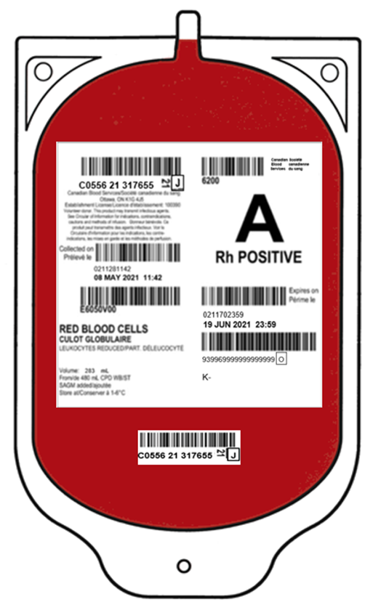
Summary: RBC unit
Blood donor/blood unit {Canadian Blood Services (CBS)} group & screen test
Phenotype:
Refers to which antigens are detectable on the red blood cells.
Is noted on the CBS label if the donor is antigen negative (the red blood cells in that unit do not have that antigen on their surface and the unit would be compatible for a patient with that antibody).
Notes:
Phenotyping is used in TM in four main settings:
• For blood donors, to determine compatibility for a patient with an alloantibody
• For blood donors, to identify donors with uncommon phenotypes
• For patients, to determine which antigens the patient lacks in order to prevent future antibody formation
• For patients, to confirm that the patient is negative for an antigen to which he has formed an antibody

Slide 24
Blood Compatibility Check Visual Aid RBC Transfusion
Blood Compatibility - RBC Transfusion
 | *Antigen(s) – on exterior surface of red blood cell *Antibody(ies) – in plasma ** Females of childbearing age/potential
 | RBC unit | Patient
ABO Blood Group
ABO Antigen(s)
ABO Antibody(ies)
Rh(D) Blood Group
Rh(D) Antigen **
Rh(D) Antibody
Clinically Significant Antibody(ies) Antigen(s) Negative **
* Ensure the patient’s plasma antibodies will not hemolyze the transfused RBC unit (the RBC unit red blood cells do not have corresponding antigen on their surface).
= Compatibility Check

Slide 25
Patient Case 1 Question
Wilma, an 80-year-old female post hip fracture surgery, is SOB when up with physio & Hb is 69 g/L. A 1-unit RBC transfusion is ordered. Wilma’s group & screen test: group O, Rh positive, antibody screen negative. TML issues RBC unit: group A, Rh positive, phenotype no information.

Slide 26
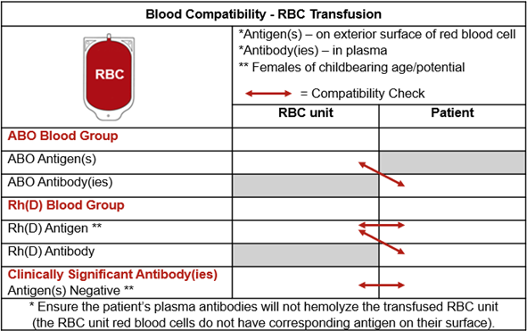
Patient Case 1 Compatibility Check
Wilma’s group & screen test: group O, Rh positive, antibody screen negative. TML issues RBC unit: group A, Rh positive, phenotype no information.
Select the most correct statement.
This transfusion is compatible because Wilma has no antigens on her red blood cells (group O) and the RBC unit’s red blood cells have A antigen (group A).
This transfusion is compatible because Wilma & the RBC unit are both Rh positive.
This transfusion is incompatible because Wilma has both anti-A and anti-B antibodies in her plasma (group O) & the RBC unit’s red blood cells have A antigen (group A).
This transfusion is incompatible because the RBC unit has no phenotype information.
A
O
A
anti-A & anti-B
Pos
Pos
D
D
No
N/A
Neg

Slide 27
Patient Case 2 Question
Betty, a 32-year-old female, is admitted post successful endoscopy to treat a bleeding ulcer. Her Hb is 62 g/L. A 1-unit RBC transfusion is ordered. Betty’s group & screen test: group B, Rh negative, antibody screen negative. TML issues RBC unit: group O, Rh negative, phenotype c-, FyA-.

Slide 28
Patient Case 2 Compatibility Check
Betty’s group & screen test: group B, Rh negative, antibody screen negative. TML issues RBC unit: group O, Rh negative, phenotype c-, FyA-.
Select the most correct statement.
This transfusion is compatible because Betty has anti-A antibody in her plasma (group B) & the RBC unit’s red blood cells have no antigens (group 0).
This transfusion is compatible because Betty & the RBC unit are both Rh negative.
This transfusion is compatible because Betty has a negative antibody screen.
This transfusion is not best practice for a non-urgent transfusion because the RBC unit’s phenotype is not K- and Betty is of childbearing age/potential.
O
B
none
anti-A
Neg
Neg
none
none
No
c-, FyA-
Neg

Slide 29
Patient Case 3 Question
Fred, a 62-year-old male, is in the OR undergoing re-do aortic valve replacement surgery. His Hb is 70 g/L. A 1-unit RBC transfusion is ordered. Fred’s group & screen test: group AB, Rh positive, antibody screen positive: anti-K, anti-JkA antibodies. TML issues RBC unit: group AB, Rh negative, phenotype no information.

Slide 30
Patient Case 3 Compatibility Check
Fred’s group & screen test: group AB, Rh positive, antibody screen positive: anti-K, anti-JkA antibodies. TML issues RBC unit: group AB, Rh negative, phenotype no information.
Select the most correct statement.
This transfusion is compatible because Fred has no ABO antibodies in his plasma (group AB) & the RBC unit’s red blood cells have antigens A and B (group AB).
This transfusion is incompatible because Fred has anti-K, anti-JkA antibodies in his plasma & the RBC unit’s phenotype is not K-, JkA- (the RBC unit’s red blood cells may have K and JkA antigens).
This transfusion is incompatible because Fred’s red blood cells have the D antigen and the RBC unit’s red blood cells do not have the D antigen.
This transfusion is acceptable because the RBC unit group AB, Rh negative is rare, expires soon, & should not be wasted.
AB
AB
A, B
none
Neg
Pos
none
D
No
NA
anti-K, anti-JkA

Slide 31
Blood Compatibility Check Visual Aid FP Transfusion
Blood Compatibility - FP Transfusion
 | *Antigen(s) – on exterior surface of red blood cell *Antibody(ies) – in plasma = Compatibility Check
 | FP unit | Patient
ABO Blood Group
ABO Antigen(s)
ABO Antibody(ies)
*Ensure the antibodies in the FP unit will not hemolyse the patient’s red blood cells (patient’s red blood cells do not have the corresponding antigen on their surface).
** Rh(D) blood group is not relevant for FP (plasma has no red blood cells, i.e., no antigens).
Notes:
What is the reason when transfusing plasma, other than the ABO antibodies, antibodies in the donor plasma are not considered Recipients/patients would have to be phenotyped to match. Also, antibodies in donor plasma could be of varying titres, so transfusion of 250ml reaction would be very mild if at all. NOW with SD & pooled plasma, those antibodies would be moot as so low titre.

Slide 32
Patient Case 4 Question
Barney, a 22-year-old male, is a trauma patient in the ED. Massive Hemorrhage Protocol has been ordered. Initially he received group O, Rh positive RBC, and group AB FP. His group & screen test is now completed. FP transfusion is requested. Barney’s group & screen test: group A, Rh positive, antibody screen negative. TML issues FP units: group AB.

Slide 33
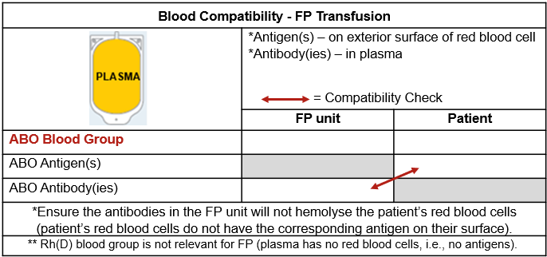
Patient Case 4 Compatibility Check
Barney’s group & screen test: group A, Rh positive, antibody screen negative. TML issues FP units: group AB.
Select the most correct statement.
Barney could be transfused group B FP (anti-A antibody) as he has A antigen on his red blood cells (group A).
Barney could be transfused group A FP (anti-B antibody) as he has A antigen on his red blood cells (group A).
Barney could be transfused group O FP (anti-A & anti-B antibodies) as he has A antigen on his red blood cells (group A).
Barney must be transfused only group AB FP (no ABO antibodies) as he has A antigen on his red blood cells (group A).
AB
A
A
none

Slide 34
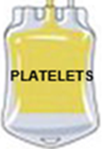
Blood Compatibility Check Visual Aid Platelet Transfusion
Blood Compatibility - Platelet Transfusion
 | *Antigen(s) – on exterior surface of red blood cell *Antibody(ies) – in plasma ** Females of childbearing age/potential = Compatibility Check
 | Platelet | Patient
ABO Blood Group
ABO Antigen(s)
ABO Antibody(ies)
Rh(D) Blood Group
Rh(D) Antigen **
Rh(D) Antibody
*Transfused platelets should be ABO compatible with patient’s red blood cells (platelets are suspended in donor plasma). Platelet components also contain a few red blood cells. If platelets are in short supply, TML policy re: ABO group substitution.
**For Rh(D) negative females of childbearing age/potential, if Rh(D) positive platelets are transfused (re: platelet supply), Rh immunoglobulin (RhIG) is required.
Notes:
BE 5.1 p. 17 Female children and people of child-bearing age/potential who are Rh(D) negative should receive Rh immunoglobulin before, after or within 72 hours of receiving an Rh(D) positive
platelet component.
BE 5.1 p. 29 Each platelet unit contains less than 10x108 red blood cells. Each 120 ug of RhIG covers 12 mL whole blood (6 mL RBC) and lasts approximately 21 days.
RhIG is not recommended for males, and females of non-childbearing potential, because risk of immunization from platelets is low (about 1%) and passive anti-D complicates compatibility testing and may delay transfusion

Slide 35
Patient Case 5 Question
Pebbles, a 33-year-old female, is undergoing induction chemotherapy for acute leukemia. Her clinical course is proceeding as anticipated. Today her platelet count is 8 x10⁹/L. A 1-dose platelet transfusion is ordered. Pebbles’ group & screen test: group A, Rh negative, antibody screen negative. TML issues Platelet unit: group A, Rh positive.

Slide 36
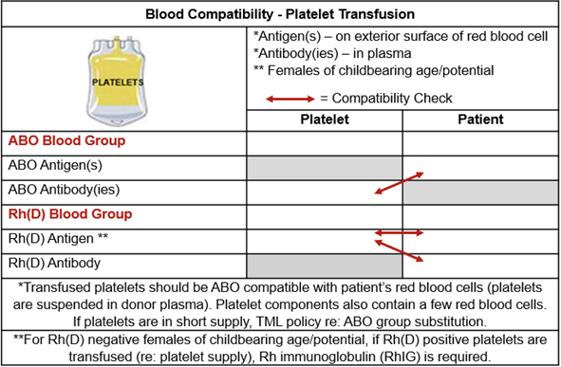
Patient Case 5 Compatibility Check
Pebbles’ group & screen test: group A, Rh negative, antibody screen negative. TML issues Platelet unit: group A, Rh positive.
Select all the correct statements.
Pebbles could be transfused group A platelets (plasma has anti-B antibody) as she has A antigen on her red blood cells (group A).
The platelets are Rh positive, and Pebbles is Rh negative, she should receive RhIG . This is to prevent Pebbles from producing anti-D antibody.
Pebbles could be transfused group O platelets (plasma has anti-A & anti-B antibodies) as she has A antigen on her red blood cells (group A).
Pebbles could be transfused group AB platelets (plasma has no ABO antibodies) as she has A antigen on her red blood cells (group A).
A
A
A
anti-B
Pos
Neg
D
none
No

Slide 37
The Elephant in the Transfusionist’s Skill Set: Understanding Compatibility for Transfusion Safety
Take Home Messages
Transfusion safety is teamwork!
Confirming compatibility is one aspect of transfusion safety.
Confirming compatibility is a transfusionist responsibility & accountability.
Compatibility starts with the group & screen blood sample.
Antigens (name badge) are on red blood cells.
Antibodies (protectors) are in the plasma.
Clinically significant antibodies (troublemakers), especially anti-D and anti-K, must be assessed.
Respect patient identification & blood labels.
When in doubt, refer to the Compatibility Table or call TML.

Slide 38
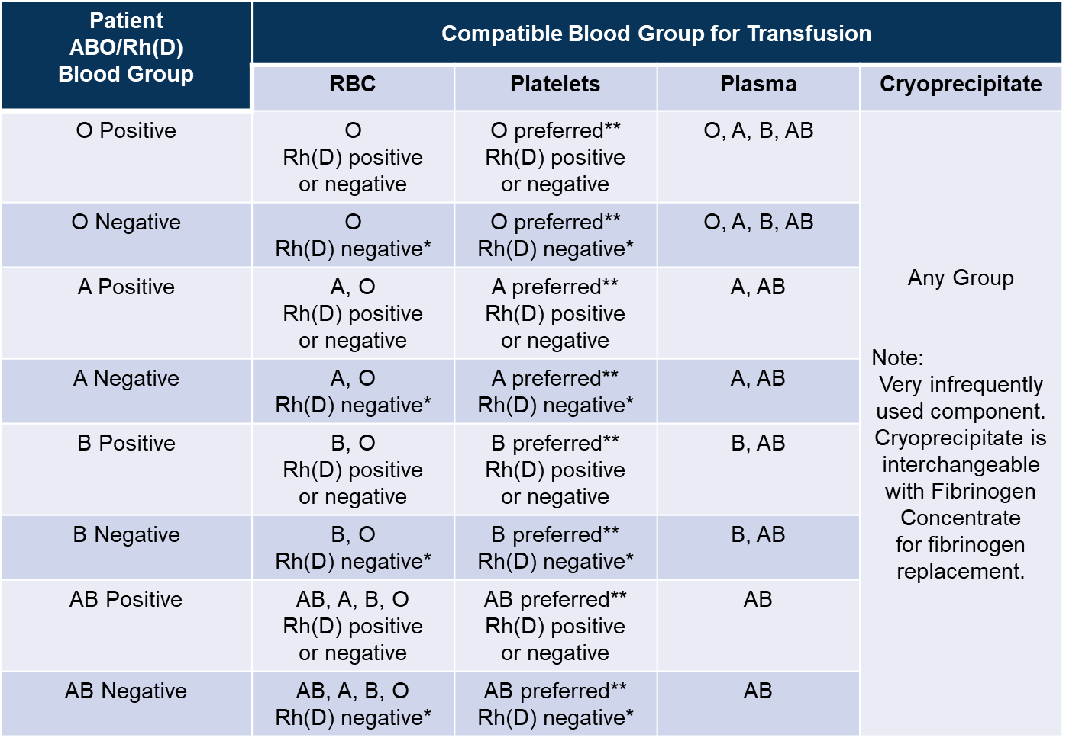
Compatibility Table
Notes:
From BEBA v3

Slide 39
Post Transfusion Knowledge Question 1
Paramedics arrive in ED with Emma, a 21-year-old female trauma patient. She is unresponsive, being intubated, unstable & bleeding. Lab tests are pending. Blood, 4 units RBC & 4 units plasma (FP), is ordered.
The safest blood for this patient, Emma is:
Group O, Rh positive RBC and group O FP.
Group O, Rh negative RBC and group O FP.
Group O, Rh positive RBC and group AB FP.
Group O, Rh negative RBC and group AB FP.

Slide 40
Post Transfusion Knowledge Question 2
An RBC unit crossmatched, compatible is safe for transfusion when:
The ABO antigens on the red blood cells in the unit of blood will not be hemolysed by ABO antibodies in the patient’s plasma.
The ABO antigens on the red blood cells in that unit of blood will be hemolysed by ABO antibodies in the patient’s plasma.
The ABO antibodies on the red blood cells in the unit of blood will not be hemolysed by ABO antigens in the patient’s plasma.
The ABO antibodies on the red blood cells in the unit of blood will be hemolysed by ABO antigens in the patient’s plasma.

Slide 41
Acknowledgements
The Ontario Regional Blood Coordinating Network (ORBCoN) gratefully acknowledges funding support provided by the Ontario Ministry of Health. The views expressed in this presentation are those of the authors and of ORBCoN and do not necessarily reflect those of the Ontario Ministry of Health or the Government of Ontario. Many thanks to my ORBCoN and Transfusion Medicine family for their ongoing mentorship and support.

Slide 42
References (1)
Callum JL, Pinkerton PH, Lin Y, Cope S, Karkouti K, Lieberman L, Pendergrast JM, Robitaille N, Tinmouth AT, Webert KE. Bloody easy 5.1 blood transfusions, blood alternatives and transfusion reactions a guide to transfusion medicine. 5th ed. Toronto: Ontario Regional Blood Coordinating Network; 2022 [revised 2023; cited 2024 Mar 18]. 145p. Available from: https://transfusionontario.org/en/category/bloody-easy-e-tools-publications/bloody-easy-for-healthcare-professionals/
Canadian Blood Services (CBS). Circular of information [Internet]. Ottawa (CA); CBS; 2023 [cited 2024 Mar 18]. Available from: https://www.blood.ca/en/hospital-services/products/component-types/circular-information
Canadian Society for Transfusion Medicine (CA). Standards for hospital transfusion services. Markham ON; 2021 Dec; cited 2024 Mar 18. 110 p. Report No.: Version 5. Available from: http://www.transfusion.ca/Resources/Standards
Daniels, G. Human Blood Group Systems. In: Murphy MF, Roberts DJ, Yazer MH, editors. Practical Transfusion Medicine [Internet]. Hoboken, New Jersey (US): John Wiley & Sons Inc; 2017 [cited 2024 Mar 18]. chapter 3. Available from: https://doi-org.libaccess.lib.mcmaster.ca/10.1002/9781119129431.ch3
Drews S, Khandelwal A, Goldman M, Devine D. Donor selection, donor testing and pathogen reduction. In: Khandelwal A, Abe T, editors. Clinical Guide to Transfusion [Internet]. Ottawa (CA): Canadian Blood Services; 2021 [cited 2024 Mar 18]. Chapter 6. Available from: https://professionaleducation.blood.ca/en/transfusion/clinical-guide/donor-selection-donor-testing-and-pathogen-reduction
Issitt PD, Anstee DJ. Applied blood group serology 4th edition. Durham (North Carolina USA): Montgomery Scientific Publications; 1998. 1232p.
Journal Compilation. Introduction to blood transfusion: donor to recipient. In: Armstrong BC, Wilkinson R, Goldman M, editors. International Society of Blood Transfusion Science Series. Vox Sanguinis [Internet]. 2020 [cited 2024 Mar 18];15(S1):1-333. Available from: https://doi.org/10.1111/voxs.12588

Slide 43
References (2)
Klein HG, Anstee DJ. Haemolytic Transfusion Reactions In: Klein HG, Anstee DJ, Mollison PL, editors. Mollison's Blood Transfusion in Clinical Medicine [Internet]. Hoboken, New Jersey (US): John Wiley & Sons Inc; 2014 [cited 2024 Mar 18]. Chapter 11. Available from: https://doi-org.libaccess.lib.mcmaster.ca/10.1002/9781118689943.ch11
Ontario Regional Blood Coordinating Network. Bloody easy blood administration. version 3. Toronto: Ontario Regional Blood Coordinating Network; 2020 [cited 2024 Mar 18]. 146p. Available from: https://transfusionontario.org/en/category/bloody-easy-e-tools-publications/bloody-easy-blood-administration/
Ontario Regional Blood Coordinating Network. Provincial massive hemorrhage toolkit [Internet]. Toronto ON; Ontario Regional Blood Coordinating Network; 2020 Jul [cited 2024 Mar 18]. Available from: https://transfusionontario.org/wp-content/uploads/2023/02/MHP_Toolkit_v2.pdf
Rout P, Harewood J, Ramsey A, Master SR. Hemolytic Transfusion Reaction. In: StatPearls [Internet]. Treasure Island (FL): StatPearls Publishing; 2023 [cited 2024 Mar 18]. Available from: https://www.ncbi.nlm.nih.gov/books/NBK448158/
Ruby KN, Harm SK, Dunbar NM. Risk of ABO-incompatible plasma from non-ABO-identical components. Transfusion Medicine Reviews [Internet]. 2021 [cited Mar 18];35(4):118–22. Available from: http://resolver.scholarsportal.info.libaccess.lib.mcmaster.ca/resolve/08877963/v35i0004/118_roapfnc.xml
Tormey CA, Hendrickson JE. Transfusion-related red blood cell alloantibodies: induction and consequences. Blood, The Journal of the American Society of Hematology [Internet]. 2019 [cited Mar 18];133(17):1821-30. Available from: https://ashpublications.org/blood/article/133/17/1821/275904/Transfusion-related-red-blood-cell-alloantibodies

Slide 44
The Elephant in the Transfusionist’s Skill Set: Understanding Compatibility for Transfusion Safety
Email: bertad@mcmaster.ca

