Slide 1
Training For Transporting Blood Products Internally

Slide 2
OBJECTIVES
Who is permitted to transport blood at your facility
What you need with you when you retrieve blood products
Your responsibilities when signing for a blood product
How long blood may be in transit
How to handle blood safely
Notes:
At the end of this session, you should be able to describe:

Slide 3
Who needs this training?
The Institute for Quality Management in Healthcare (IQMH) requirements state that ALL staff who transport blood from the Transfusion Medicine (TM) Laboratory to a Nursing Unit have regular training.
Policies, processes and procedures shall be established for: a. training of personnel involved in the packing and transportation of blood components and blood products b. documentation of training c. internal assessment to ensure compliance with established procedures 9.5.1
Reference:
Canadian Society for Transfusion Medicine Standards for Hospital Transfusion Services, Version 4, Ottawa, ON: Canadian Society for Transfusion Medicine, April 2017:5.7.1.2

Slide 4
Staff permitted to transport blood products are:
Ward clerks
Porters
Registered Practical Nurses (RPN)
Registered Nurses (RN)
<Add any others who may be permitted or designated as not being permitted at your facility>
This would include volunteers, students, agency as per facility policy

Slide 5
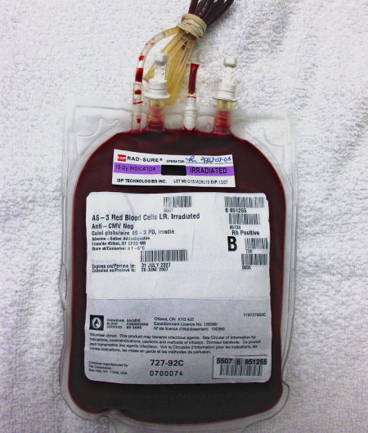
Blood Products:
Any item supplied by the TM Lab
Red Blood Cells
If it is not being transfused, it cannot be out of the TM Lab refrigerator for more than 60 minutes

Slide 6
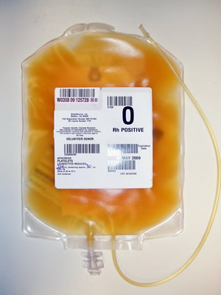
Blood Products:
Any item supplied by the TM Lab
Platelets
Must stay at room temperature at all times

Slide 7
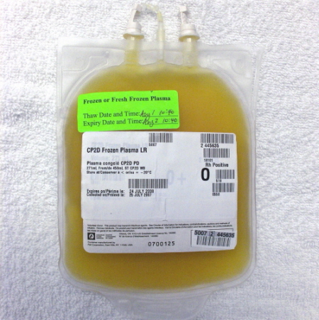
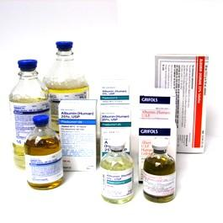
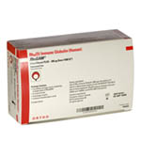
Blood Products:
Any item supplied by the Transfusion Services
Other Blood Products may include Plasma or Plasma Derived Products

Slide 8
Before coming to the laboratory:
You Must:
Obtain printed Patient ID, such as a patient label/requisition, that clearly shows the patient’s full name and one other unique identifier
Ensure you are wearing your hospital ID badge
Ensure you know what blood product you are picking up
The TM lab will NOT issue product if any of the above are missing

Slide 9
On arrival at the laboratory:
Present the patient ID (label or requisition) to the lab staff. Provide the lab staff with your ID
Providing the Patient ID will ensure that the correct product is issued and sent with you
If no laboratory staff are available, and you have the authority to do so, proceed to designated acceptable storage equipment for blood products

Slide 10
Verify Patient ID by:
Using the Patient ID (label or requisition) :
Compare correct patient name and one other unique identifier on the issue voucher/tag/label or card, attached to the blood product
If the information is not the same DO NOT REMOVE FROM LAB
Inform the laboratory staff of the discrepancy

Slide 11
Verify the blood product by:
Comparing the Patient ID (label or requisition) :
Compare correct product has been prepared for transporting up to clinical unit like…
Red Blood Cells Plasma
Platelets Other products
If no laboratory staff are available, and you are authorized to do so, verify using the patient ID (label or requisition) to :
Compare the blood product number
The Blood Group (if applicable)
If there is a discrepancy DO NOT REMOVE FROM LAB
Inform the laboratory staff of the discrepancy

Slide 12
Why is it important to select the correct component for the patient?
DONOR UNIT Blood Type
 |  | O- | O+ | B- | B+ | A- | A+ | AB- | AB+
PATIENT BLOOD TYPE | AB+ | ✓ | ✓ | ✓ | ✓ | ✓ | ✓ | ✓ | ✓
 | AB- | ✓ |  | ✓ |  | ✓ |  | ✓
 | A+ | ✓ | ✓ |  |  | ✓ | ✓
 | A- | ✓ |  |  |  | ✓
 | B+ | ✓ | ✓ | ✓ | ✓
 | B- | ✓ |  | ✓
 | O+ | ✓ | ✓
 | O- | ✓
Wrong blood may cause acute hemolytic transfusion reactions that can result in
Fever, chills
Pain
Shortness of breath
Low blood pressure
Shock
Possible death
Acceptable blood types the receiving patient can tolerate

Slide 13
If You Agree that the Information on All Documents is Identical
Both the laboratory staff member and you will sign the issue documentation
The laboratory staff member will give you the blood product
You are ready to take blood to clinical unit
If there is no laboratory staff available, and you are authorized to do so:
Perform visual inspection of product and complete documentation required
Sign the issue documentation with another qualified staff member

Slide 14
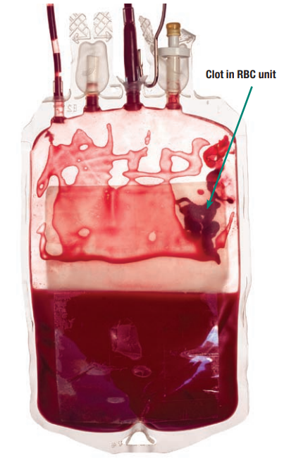
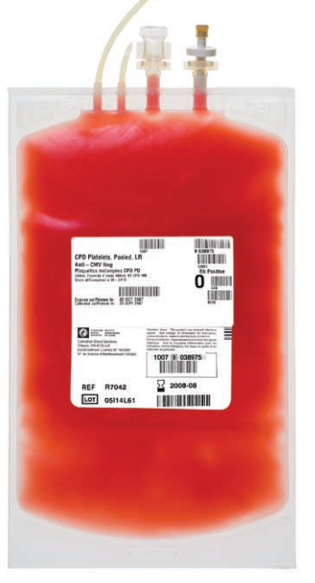
Inspect the Component
Red Blood Cell Units
Platelet Units
Visually inspect for the following:
Hemolysis
Lipemia (strawberry milkshake
Particulate matter (clots & fibrin strands)
Visually inspect for the following:
Red cell contamination
Lipemia (milky appearance)
Icterus (Bright yellow to brown
Bacterial contamination
Particulate Matter (cellular aggregates)
CBS - Visual Assessment Guide T05 21 Jan 2009
Notes:
For more information please visit https://professionaleducation.blood.ca/sites/msi/files/VAG_en.pdf

Slide 15
Do’s and Don’t’s
How to Handle Blood Safely
DO: take the blood product directly from the laboratory to the clinical unit in the container in which it was issued to you, without delay
DO: Ensure that you hand the blood product over to patient care area staff
DO NOT exceed 10 minutes for transit time from the laboratory to the clinical unit
DO NOT take blood products through the cafeteria or outside the building on your way to the clinical unit
Blood products MUST NEVER be placed in any
refrigerator outside of the laboratory
or near a heat source

Slide 16
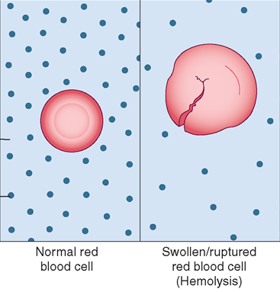
What happens if blood is exposed to extreme temperatures?
Blood can hemolyze if it gets too hot or too cold
When blood cells hemolyze they can’t carry oxygen to tissues
Notes:
If the blood component is kept out of the 1-10°C temperature range longer than 60 min, it may cause the RBCs to hemolyze and may not be able to facilitate the improvement of the patient’s outcomes

Slide 17
How to Handle Blood Safely
Use good hand hygiene after handling any blood product:
And before:
Proceeding to your next duty
Eating
Drinking
Smoking
Applying cosmetics

Slide 18
If at any time you notice that a blood product is leaking:
Place the product in a biohazard bag
Transport the blood product back to the laboratory if this can be done safely
Wash your hands thoroughly, remove any contaminated clothes (obtain a set of hospital scrubs to wear)
Notify the TM lab for further directions –blood must always be accounted for
Complete an incident report as per facility policy

Slide 19
If you are asked to return a blood product to the laboratory:
Take the blood product directly to the laboratory as quickly as possible
The product may be reissued for another patient if returned back into the lab within 60 minutes of issue and it remains at an acceptable temperature
Hand the product over to a member of the lab staff i.e. ensure someone is aware you have returned the blood
There are time and temperature limits for blood products to be out of the special refrigerators in the lab

Slide 20
Any questions or suggestions
Contact the Laboratory/Transfusion Service
<Enter contact information here>

