Slide 1
Transporting
Blood Internally
(within your hospital)
Learning Module

Slide 2





OBJECTIVES
Understand: obligations associated with transporting blood.
After completing this session participants will be able to:
Identify: the healthcare workers approved to transport blood at [Your facility name].
Define: the information required to pick up blood from TML (Transfusion Medicine Laboratory/Blood Bank).
Explain: actions to handle blood safely.
Describe: the length of time blood can be in transit.

Slide 3
WHY IS TRANSPORTING BLOOD SAFELY IMPORTANT?
Patient Safety First:
Transporting blood safely is vital for patient’s well-being.
Incorrect actions when picking up or handling blood could lead to patient harm.
Following the guidelines and best practices ensures that blood arrives safely to the patient.
Within a facility
Operating procedures shall be in place that clearly define:
  Individuals who may pick up blood components from the transfusion service and transport them to the recipient’s location;
  Transportation conditions and acceptable time frames for blood components to be in transit
  Acceptable time frames from the time blood components are released from the transfusion service until the time the transfusion is completed and
  Appropriate processing and storage procedures.
*Operating procedures is an excerpt from the CSA Standards Clause 9.5.3*

Slide 4





UNDERSTANDING BLOOD
Includes any items supplied by the TML, categorized as blood components or blood products.
TML staff tests the patient’s blood sample and ensures that the blood to be transfused matches the patient’s blood.
Each component or product is prepared by the TML for each individual patient and has a unique identification number that is tracked.
Blood components and products have specific temperature requirements.
Only 1 blood component or product is issued (picked up) from TML at one time. Exceptions might include an emergency transfusion/bleeding patient or if a temperature validated transport container is used.

Slide 5
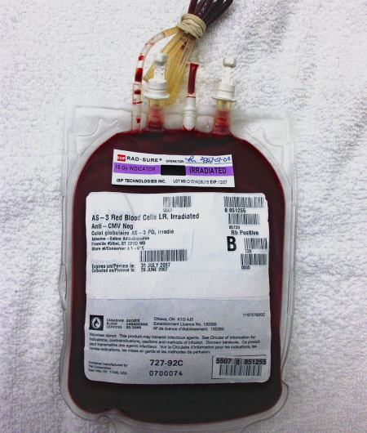
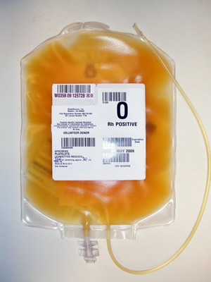
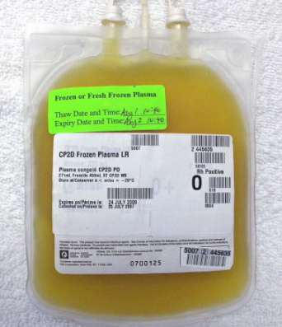
BLOOD COMPONENTS:
Red Blood Cells, Platelets, Plasma
Specific expiry time is based on removal from its temperature-controlled environment (4 hours from time issued from TML)
Red blood cells: Stored at 1-6°C (TML refrigerator)
Platelets:
Stored at 20-24°C
(TML, room temperature)
Plasma:
Frozen:
stored at minus 18°C or colder (TML freezer)
Thawed:
stored at 1-6°C for up to 5 days

Slide 6
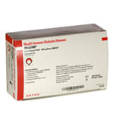
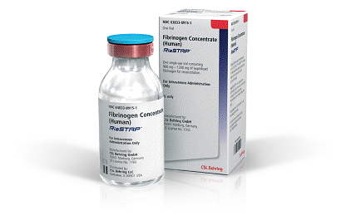
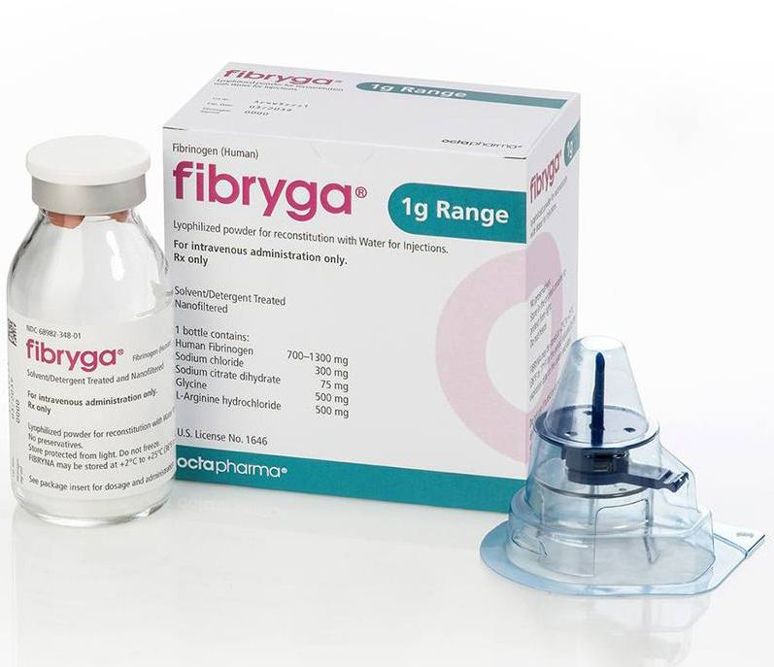
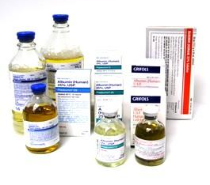
BLOOD PRODUCTS (Manufactured from Plasma)
Specific expiry time is based on time of reconstitution or time of spiking/entering the bottle/vial

Slide 7
WHO CAN TRANSPORT BLOOD AT
[Hosptial: Add Facility Name]
Administrative Assistants (Ward or Unit Clerks)
Personal Support Workers (PSWs)
Porters
Registered Practical Nurses (RPN)
Registered Nurses (RN)
[Hospital: Add any others who may be permitted or designated as not being permitted per your policy, this might include prescribers, students, volunteers]

Slide 8

INFORMATION REQUIRED TO PICK UP BLOOD
    Printed or electronic Patient Identification e.g., patient label/requisition, legibly showing
        Patient’s surname, first name and
        Unique hospital identification number
  2. Ensure you are wearing your hospital identification badge
  3. Ensure you know the name of the blood component or product to be picked up, e.g., Red blood cells, Albumin, IVIG
TML will NOT issue blood if any of the above
are missing

Slide 9

ON ARRIVAL AT TML
Provide your hospital identification.
Present the patient identification to TML staff.
    Providing the patient identification ensures that the correct, “matched blood” is issued and sent for the patient.
If TML staff and you both agree the patient surname, first name, and unique hospital identification number are identical, per your hospital’s specific policy, sign the issue documentation.
You are ready to take the blood/ blood component to the patient location.

Slide 10
If Your TML Is Not Staffed 24hrs/Day
Only trained and authorized personnel may retrieve blood components when the TML is not staffed.
Follow your hospital’s specific policy and procedure.
[Hospital: include specific details]

Slide 11


SAFE TRANSPORT: Know Your Responsibilities
DO: Without delay, take the blood directly from TML to the patient location, in the container in which it was issued.
DO: At the patient location, hand the blood over to a staff member and ensure the staff member acknowledges receipt of the blood

Slide 12


SAFE TRANSPORT: Know Your Responsibilities
DO NOT: Take blood through the cafeteria or outside of the building on your way to the patient location.
DO NOT: Place blood in any refrigerator outside of TML or near a heat source. - If blood is exposed to extreme temperatures and then transfused, it could cause harm to the patient.
DO NOT: Exceed 15 minutes for transit time from TML to the patient location.
[Hospital: Per your specific policy detail, up to 15 minutes is reasonable, a time limit is not noted in TML standards]
DO NOT: Leave blood unattended, even for a moment. Never leave it at the nursing station

Slide 13

HANDLING BLOOD SAFELY
Perform hand hygiene after transporting blood
Before:
Proceeding to your next duty
Eating
Drinking
Smoking
Applying cosmetics

Slide 14
NOTICE THE BLOOD IS LEAKING?
Protect yourself, immediately put on gloves.
Place the blood in a biohazard bag.
Notify TML for further direction.
Transport the blood back to TML, if this can be done safely.
Wash your hands thoroughly, remove any contaminated clothing.
Complete an incident report as per hospital policy.

Slide 15
RETURNING BLOOD TO TML
Take the blood directly to TML, without delay.
The blood may be returned to inventory and subsequently issued to another patient, if TML policies* are met and the blood is returned within 60 minutes of issue.
Hand over the blood to TML staff i.e., ensure someone is aware the blood has been returned.
Policies include visual inspection, temperature, and time limitations for blood outside the TML temperature-controlled environment.

Slide 16
ANY QUESTIONS OR SUGGESTIONS?
Contact TML
  <Enter contact information>
Link to Hospital Transporting Blood Policy
  <Enter link and/or QR Code>

