Slide 1
Provincial Redistribution Program for Transfusion Services in Ontario
Training
2018

Slide 2
Why We Ensure Components and Products are Utilized Appropriately
Products | Cost
1 unit of RBC | $411
1 unit of Pooled Platelets | $174
1 unit of Apheresis Platelets | $492
1 g of IG | $65
1 vial of Octaplex (500IU) | $355
Factor Concentrates | $265 - $6,039
Notes:
All of us want to ensure that products and components are being utilized efficiently, as blood is a gift given by generous people and sometimes may be in short supply. Hospitals in Ontario have agreed to redistribute all blood components and products when feasible to ensure that these precious gifts are not wasted as much as possible. Hospitals also need to ensure that when shipping blood components between facilities for any reason, that they are following validated standardized procedures to ensure the components/products safety and efficacy.

Slide 3
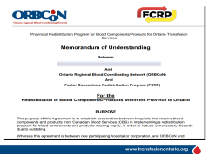
Memorandum of Understanding
Identifies and documents responsibilities for each partner in the provincial redistribution program
Agreement between the signing facility and ORBCoN/FCRP
Return to ORBCoN and will be kept on file
Notes:
Hospitals across Ontario follow the IQMH requirements for accreditation in Transfusion Medicine, but hospitals vary when it comes to access to freezers and their temperature ranges. The MOU outlines the responsibilities for both shipping hospitals and receiving hospitals for shipping components and products between facilities. It provides the reassurance needed for all sites that may receive components/products that they were transported following validated methods based on pre-conditioning of ice packs and gel packs.

Slide 4
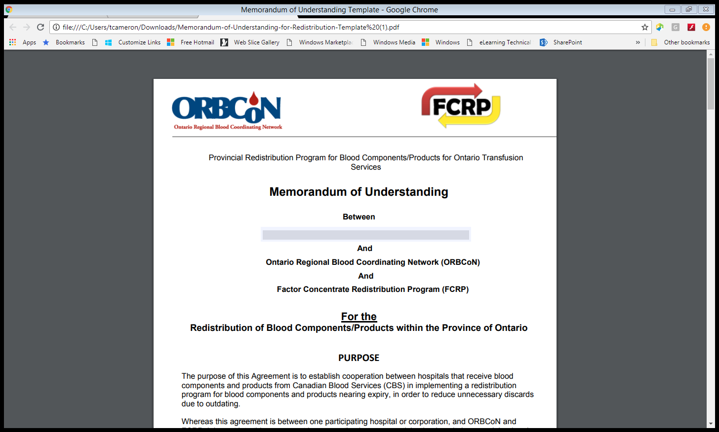

Slide 5
Shipping Blood Components (Fresh Products) using J82/E38 Shipping Containers
Notes:
Let’s review the process for shipping blood components using the J82 and E38 shipping containers

Slide 6
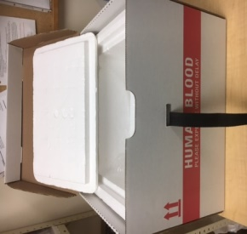
Red Blood Cells
Red cells are shipped using a J82 box
Up to 8 units can be shipped at a temperature of 1 to 10 °C
Conditioning:
  Freezer packs -25 to -40 °C for a minimum of 6 hours
  Gel packs at 2-6 °C for a minimum of 6 hours
Notes:
Depending on the agreement set up between facilities to redistribute RBCs, a good rule of thumb is to redistribute when there is between 7 and 14 days remaining of shelf life. Your site will need to confirm with the receiving site what the acceptable time remaining should be before shipping out. Reminder to always confirm with the receiving site before shipping any product.

Slide 7
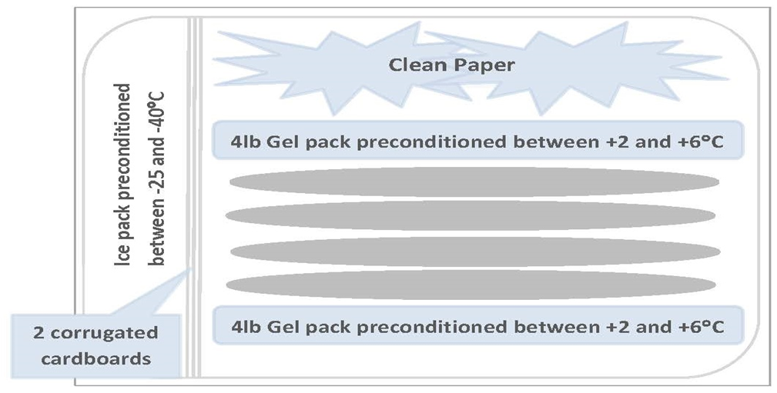
Packing Configuration for J82 Shipping Container
Shipping 1 – 8 RBC units
Notes:
There is a change in the packing configuration for those sites that pre-condition ice packs between -25C and – 40C that are used to ship blood components in the J82 shipping containers. This packing configuration has been validated and the report can be found at transfusionontario.org. For those sites that pre-condition the ice packs outside of these temperature parameters, a validation must be done and report made available upon request from any site that receives shipments from your site.

Slide 8
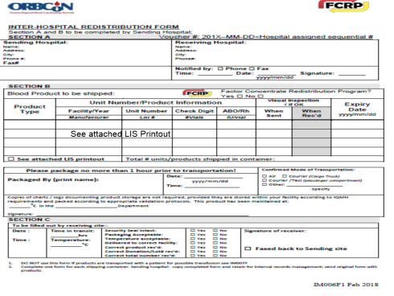
Interhospital Redistribution Form
Notes:
This form is to be used with all redistribution shipments including fresh products and plasma protein/factor concentrate products. Complete Section A (include a unique voucher number for traceability, could be batch transfer number if your LIS generates one, if not, sites have to generate their own number and track it)
Section B can be completed by manually entering required unit/lot number information or using your LIS print out. If you use your LIS print out then be sure to state in the box in section B.

Slide 9
See attached LIS Printout

Slide 10
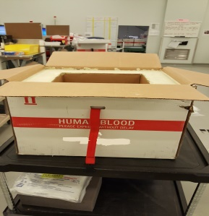
Platelets
Platelets are shipped using an E38 box
Up to 6 units can be shipped at a temperature of 20-24°C
Conditioning:
  Gel packs 20-24°C for minimum of 6 hours
Notes:
Platelets can remain in this box for up to 24 hours at room temperature. If you know your site will not be using the platelet for any patient, then contact a hospital that may be able to use it as soon as possible.

Slide 11
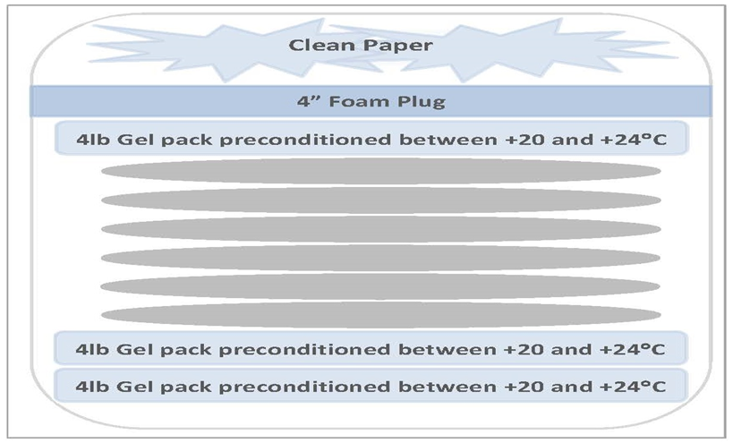
Packing Configuration for E38 Shipping Container
Shipping 1-6 PLTs
Notes:
Here is the packing configuration to be used with E38 shipping containers to maintain RT between 20C and 24C. You can ship up to 6 units of platelets in one shipping container. This packing configuration has been validated and the report is available on transfusionontario.org

Slide 12
Shipping Blood Components (Fresh Products) using MTS Shipping Containers
Notes:
Some hospitals are using a shipping container that utilizes phase change material to maintain optimal shipping temperatures.

Slide 13
Credo Cube EMT
  Credo Cube EMT (formely MTS) shipping container uses “Phase Change” material to maintain a temperature of between 1°C and 10°C for a specified period of time.
  Preconditioning
  Used for redistribution
Container | Shipping Environment Temperature | Pre-Condition Temperature/Time
Credo Cube EMT | >4ºC | -18 ºC to -40ºC For minimum of 8 hours
 | ≤4ºC | 4 ºC to 6ºC For minimum of 6 hours
Notes:
An alternative that some hospitals are using to redistribute RBCs is the Credo Cube EMT shipping container. This uses the same technology that the new Canadian Blood Services shipping containers use. These containers are designated for redistribution only and are usually used between groups of hospitals that have a courier system set up to have these containers returned to the shipping facility.

Slide 14




Credo Cube EMT
Packing maximum 4 RBCs in the EMT shipping container
1) Precondition the Thermal Insulated Chamber (TIC) system then pack as below
Notes:
It is important to allow the TIC to sit out at room temperature for a time to ensure it is not too cold. Allow frost to dissipate from TIC prior to packing RBCs

Slide 15
Credo Cube EMT
  Pack within 20 minutes of courier pickup
  Blood components requiring a temperature range outside of 1°C-10°C must be shipped using a container other than the MTS EMT container
Notes:
Like shipping RBCs, packing is recommended to be done 20 minutes prior to courier pick up to ensure that the enclosed components/products do not exceed the allowable time for shipping.

Slide 16
Frozen Products
Frozen products can be shipped using a J82 box
Up to 6 units can be shipped in dry ice to maintain the frozen state
Request dry ice from supplier in advance of shipping day
Notes:
Frozen products can now be shipped to a facility for redistribution or transfer with a patient using the J82 shipping containers. Dry ice is still recommended to be used to maintain the product in the frozen state. Shipping thawed plasma should follow the same procedure as shipping RBCs.

Slide 17
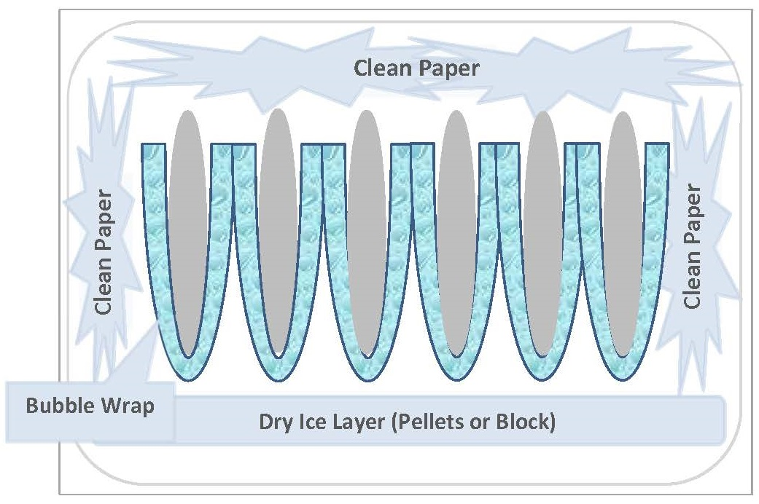
Packing Configuration For J82 Shipping Container – Frozen Plasma
Notes:
You can pack up to 6 units of Frozen plasma per J82 shipping container. Ensure there is at least 2 inches of dry ice on the bottom of the container before placing the frozen units up right wrapped in bubble wrap. Once the units are in place you can add more dry ice around the units if available. Use clean paper to fill any dead space before closing the container.

Slide 18

Knowledge Check Point
How many units of RBC’s can be shipped using the J82 shipping container?
How many PLT’s can be shipped using the E38 shipping container?
How many Frozen Plasma can be shipped using the J82 shipping container?
What temperatures were the ice packs and gel packs validated at for pre-conditioning for shipping RBCs and PLTs?
What form should be used when sending any products for redistribution to another facility?
Notes:
8 RBC units can be shipped using the J82 shipping container
6 PLTs can be shipped using the E38 shipping container
6 Frozen plasma units can be shipped using the J82 shipping container
Ice packs have been validated at pre-conditioning temperatures between -25 and -40°C while Gel packs have been validated at pre-conditioning temperatures between 2-6°C for the J82 shipping container and 20-24°C for the E38 shipping container. All should be pre-conditioned for at least 6 hours.
The Interhospital Redistribution form (IM006 F1) should be used when redistributing any product between facilities.

Slide 19
Shipping Blood Components (Fresh Products) with a Patient using J82/E38 Shipping Containers

Slide 20
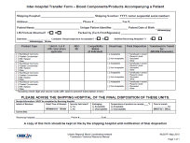
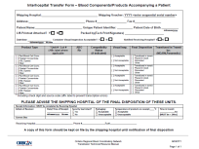
Transfer with a Patient
Patient identity known or unknown follow hospital protocol for component selection
Prepare the blood components/products to
be transported with the patient, following hospital protocol
Visually inspect the unit and complete the Inter-hospital Transfer form
Blood Components/Products
Accompanying a Patient
Notes:
When labs are notified that a patient is being transferred to another facility and will require components to be transported with them, then facilities can continue to use the J82 shipping containers to accommodate this request.

Slide 21
Notes:
An updated provincial inter-hospital transfer form needs to be completed by the sending site. This form must be received into the receiving facility's laboratory once the patient has arrived and final disposition of the components/products must be communicated back to the shipping facility to update their records. This form can be downloaded from transfusionontario.org

Slide 22
Transfer with a Patient
Follow packing configurations seen in previous section
Notify the destination Transfusion Service if known and fax the Interhospital Transfer Form (IM007F1)
This is very helpful for reporting and tracking on patient arrival at destination facility

Slide 23
Transfer with a Patient - Reporting
Sending Facility
  Complete Interhospital Transfer Form (IM007F1)
  Retain a copy
  Notify the receiving facility Transfusion Service
  Fax Inter-hospital Exchange From
  Receiving Facility
  Verify if units were transfused en route?
  Ensures number of components received equals the number sent or transfused
  Ccompletes receipt information on Interhospital Transfer form (IM007F1) and notifies the sending site of final disposition.

Slide 24
Knowledge Check Point
What shipping container should be used to ship products/components with a patient transfer?
What form should be completed and sent with the components/products with a patient that is being transferred to another facility?
Who is responsible for notifying the receiving hospital that products are traveling with a patient enroute?
Notes:
The J82 should be used when transferring components/products with a patient to another facility.
The Interhospital Transfer Form – Blood Components/Products Accompanying a Patient (IM007 F1) should be completed and shipped along with the components/products that are going with a patient.
The shipping site should notify the receiving hospital laboratory that products are being sent with a patient enroute to their facility.

Slide 25
Plasma Protein Product Redistribution

Slide 26
Overview of Process
CBS Product Listing and Monthly Expiring list
Hospital Bi-Monthly Expiry Report
Data Entry of Completed Hospital Reports
Review of Products that will be Expiring
Coordinate Shipping of Near to Expire Products
Notes:
CBS Product list is sent to ORBCoN and FCRP every month that lists all new products and lot numbers that are available for hospitals to order for their stock inventory. This is the list that ORBCoN uses to send a bi-monthly expiry report to the hospitals.

Slide 27
Hospital Expiry Report
Hospitals participating in the redistribution program will receive a plasma protein product expiry report generated by ORBCoN on the 15th ± 3 days bimonthly
Hospitals complete and submit the expiry report
The information is entered into a database that is shared with the Factor Concentrate Redistribution Program
Notes:
Hospitals that have agreed to participate in the redistribution program will receive a plasma protein product expiry report that is generated and sent by email on a bimonthly cycle around the 15th ± 3 business working days. Hospitals are to review this list and identify which products are in inventory that will need to be redistributed. Hospitals do not need to report how many vials they have in their inventory if they know that the products will be used by patients prior to expiry. ONLY report those that will need to be redistributed.
Hospitals are also asked to report their wasted and expired products on this report as well. ONLY report what has expired or been wasted between report cycles.

Slide 28
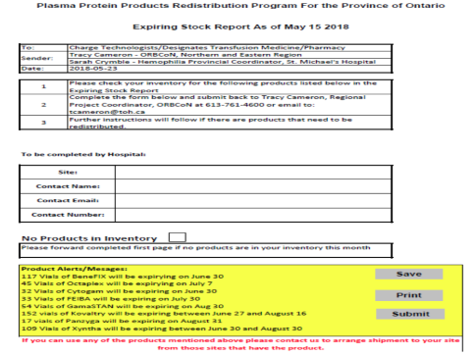
Hospital Expiry List

Slide 30
Ensure that this section is completed before sending report
You can indicate no products in inventory here
This is a listing of products that are nearing expiry that are out in the hospitals

Slide 31
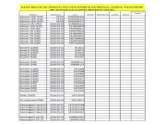
Review of Expiring Products
Review status of products previously reported
If there is no final status of products that were previously reported, ORBCoN will follow up by email with the facility to identify the final disposition of products previously reported.
ORBCoN and FCRP will pull out all products expiring within the 4-6 month timeframe and try their best to redistribute the products.

Slide 33
The first part of the report is a list of products that have previously expired. Indicate how many vials you have expired, wasted, broken or redistributed based on previous reports.
If you previously reported product in your inventory and have since used it, you can indicate it here.

Slide 34
The second part of the report is a list of products expiring within the next 6 months.
Only indicate the number of vials that need to be redistributed
Indicate how many vials have been previously redistributed, wasted and broken
If any of the previously reported products have been used, please indicate here
Notes:
ORBCoN keeps track of what has been previously reported, if hospitals have indicated in any of their reports of products in inventory requiring redistribution, but still do not have a final disposition in the system, they will follow up with that site to identify the final disposition. ORBCoN can not assume that it was transfused or shipped to another site.

Slide 35
Coordinate Near to Expiring Products
ORBCoN and FCRP will:
Contact the hospital that has the product to verify that it’s still in inventory and make arrangements to have the product redistributed to another facility
Follow up with potential receiving hospitals of certain products
Confirm shipping arrangements between both sites
If no courier service is available for sites set up external courier (PDS, Purolator)
Notes:
Once all reports are entered into the system ORBCoN and FCRP will identify the expiring products that need to be redistributed and contact hospitals to verify that they still have the product in their inventory and if they do require it to be redistributed. Once confirmed that redistribution is required, ORBCoN and FCRP will make every effort to redistribute the product to another facility. If there is not a courier system in place between facilities then external courier services will be arranged either by the shipping hospital or by ORBCoN.

Slide 36
Knowledge Check Point
How often does the expiry report get sent to participating hospitals in Ontario?
Do you have to indicate all vials in your inventory on the report?
What is the cut-off expiry date for product to report for redistribution?
Do you have to report what has been used since last report?
Notes:
Every 2 months.
No you do not have to indicate all products that are in your inventory. Just the products that you are confident will need to be redistributed. If the product will be used before it expires, then it does not need to be reported on the form.
Between 4 and 6 months. Trying to redistribute products with less than 1 month is extremely hard to do.
Yes reporting the status of what was reported the previous report is important, so that we know whether or not it has been used, discarded or needs to be redistributed. Every product that is reported to us needs to have a final disposition assigned to it to close the loop.

Slide 37
Plasma Protein Product Redistribution
Shipping Blood Products (PPP’s) using J82/E38 Shipping Containers

Slide 38
Shipping and Storage Temps
Shipping and storage temperatures vary between plasma protein products
Choose the appropriate shipping container and packing configuration
Check here if you are unsure of the requirements of the specific component that you are shipping:
http://transfusionontario.org/en/download/plasma-protein-product-acceptable-shipping-and-storage-requirements/
Notes:
Because different manufacturer’s have different acceptable shipping temperatures that differ from storage temperatures for different products, be sure to double check the shipping temperature range listed on the acceptable shipping and storage requirements document listed in this slide.

Slide 39
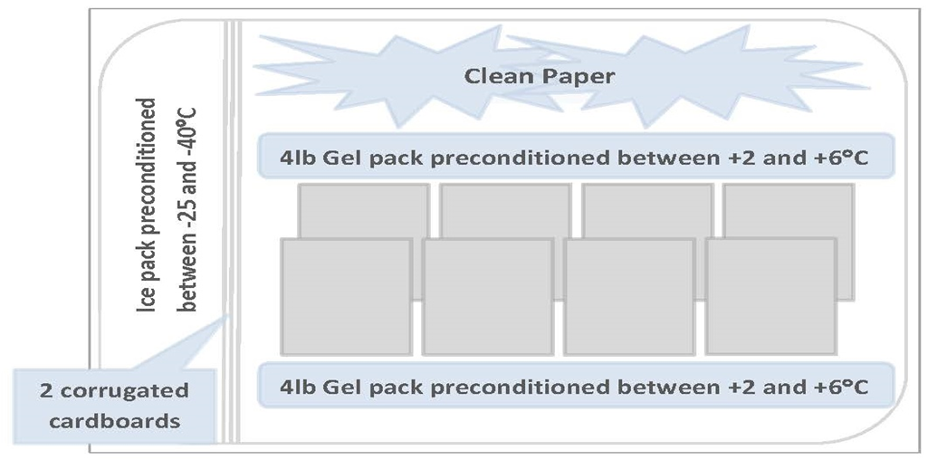
Packing Configuration for J82 Shipping Container
Shipping (2- 25°C) PPP products
Notes:
Validated packing configuration

Slide 40
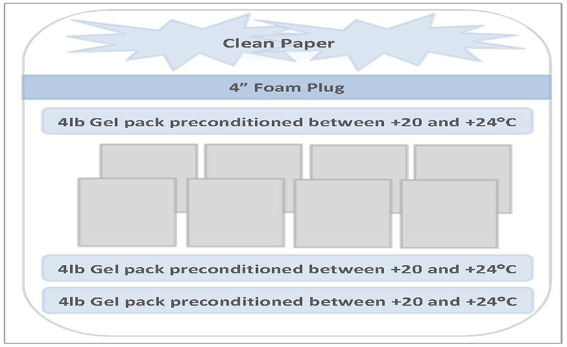
Packing Configuration for E38 Shipping Container
Shipping (19-25°C) PPP
Notes:
Validated packing configuration

Slide 41
Knowledge Check Point
Which shipping container should be used to ship products that have an shipping temperature between 2 and 8C?
Where can you find the validation report for J82/E38 Shipping Container?
Notes:
Products that have a shipping temperature between 2 and 8C should be shipped in J82 shipping containers only. Products that have a shipping temperature between 2 and 25C can be shipped in either the J82 or E38 shipping containers. Most hospitals will only be stocking the J82 shipping containers though.
Visit transfusionontario.org under the Redistribution Toolkit section for validation reports for the shipping containers used for redistribution of PPPs.

Slide 42


Avoid shipping in extreme temperatures
Shipping container should be transported inside the passenger compartment of the vehicle
Notify receiving site of expected delivery
Inspect shipping containers and packing materials for wear/damage and discard as appropriate
Pack containers as close to shipping time as possible
Notes:
Neither shipping containers work well in extreme cold temperature shipping environment (<-30°C) or extreme hot temperature shipping environments (>30°C). Therefore it is recommended that if the shipping containers will be exposed to extreme temperatures for a prolonged period of time then it is best not to ship and wait for more favourable temperatures.
Always notify the receiving hospital of shipment/transfer of components/products
Inspect the shipping containers to ensure the integrity of them is intact and suitable for shipping components and products. Request replacements from CBS when needed.
Always pack the containers as close to the shipping time as possible to ensure that the components/products are received in acceptable temperatures and acceptable timeframe.

Slide 43
Ensure that the all paperwork/labels are completed and attached
  IM.006F1 Inter-hospital Redistribution Form
  IM.006F2 Shipping Address Label
  IM.007F1 Inter-hospital Transfer Form – Blood Component/Products Accompanying a Patient
  IM.007F2 Shipment of Blood Components Accompanying a Patient Shipping label
Discontinuation of agitation of platelets during transport should not exceed 24 hours
Ensure that tamperproof device is in place!!!!!
Notes:
Neither shipping containers work well in extreme cold temperature shipping environment (<-30°C) or extreme hot temperature shipping environments (>30°C). Therefore it is recommended that if the shipping containers will be exposed to extreme temperatures for a prolonged period of time then it is best not to ship and wait for more favourable temperatures.
Always notify the receiving hospital of shipment/transfer of components/products
Inspect the shipping containers to ensure the integrity of them is intact and suitable for shipping components and products. Request replacements from CBS when needed.
Always pack the containers as close to the shipping time as possible to ensure that the components/products are received in acceptable temperatures and acceptable timeframe.

Slide 44


